Slide 1
Encounter Him Part 1
Eucharistic Adoration

Slide 2
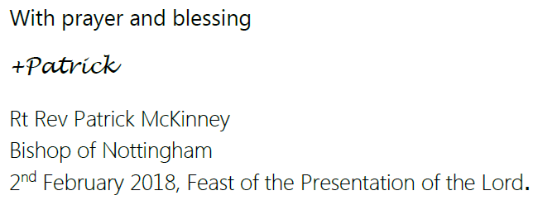
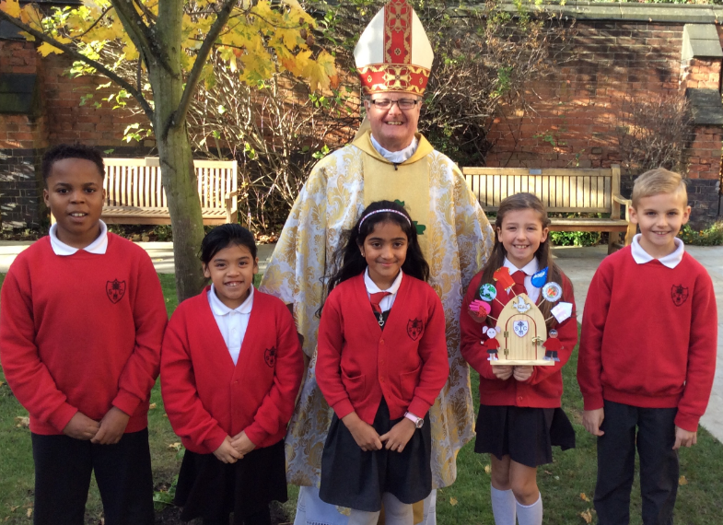
Bishop Patrick has written us a letter.

Slide 3
What is a Eucharistic Congress?

Slide 4
What is Eucharistic Adoration?
Key Question: What does Consecrated mean?
Partner Talk: Have you ever taken part in Eucharistic Adoration? What happened?
How did it make you feel?

Slide 5
A message from Bishop Patrick
Please click picture to play video

