Slide 1

Encounter Him
Part 2
Eucharistic Adoration

Slide 2
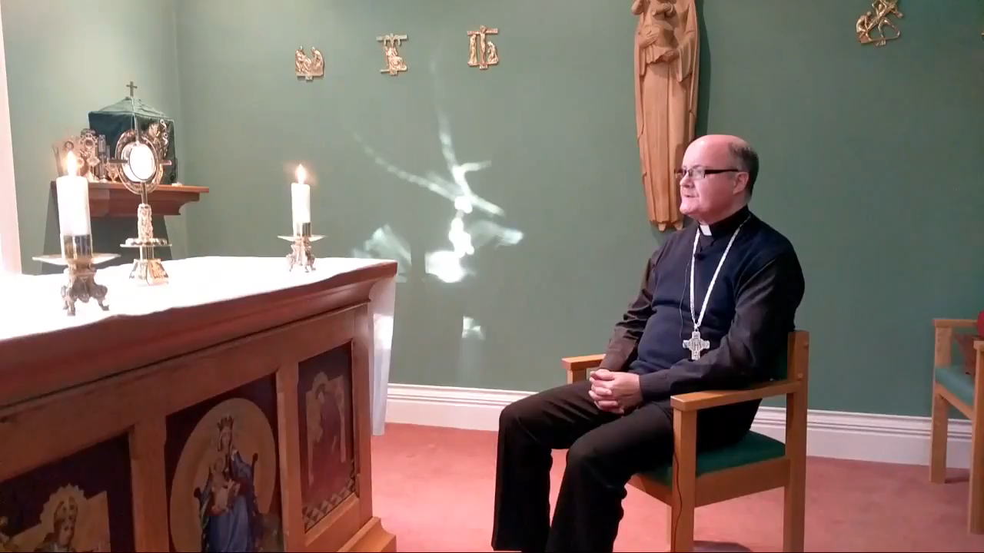
What do you bring to God during Eucharistic Adoration?
Please click picture to play video

