Slide 1

Encounter Him
Part 3
Eucharistic Adoration

Slide 2
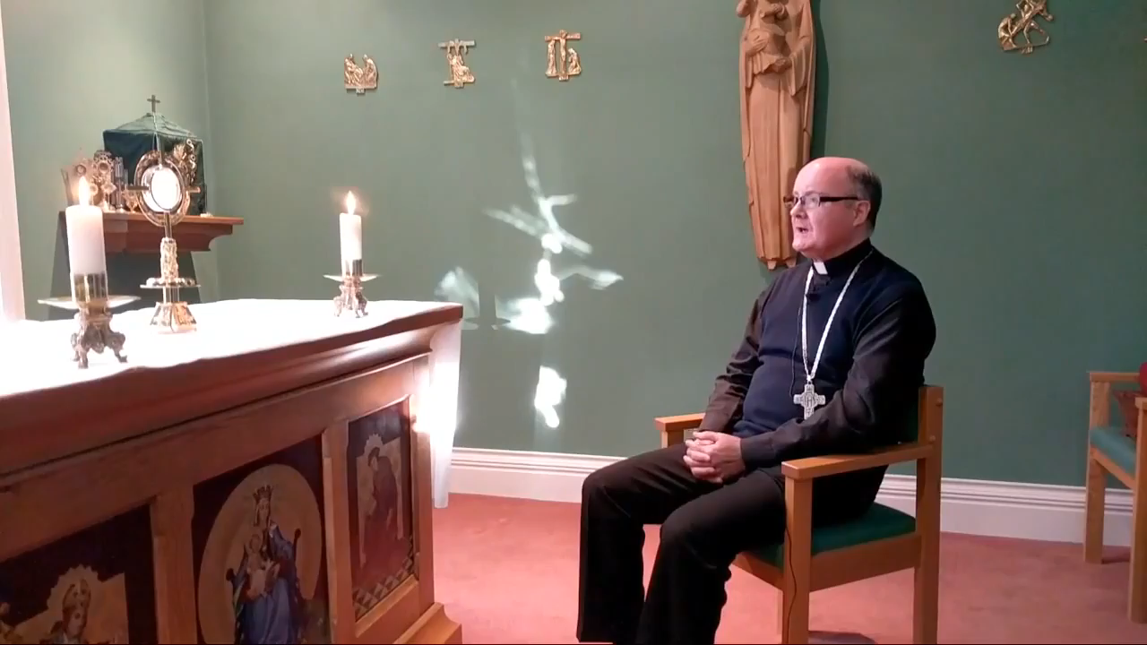
What do you do at the end of Eucharistic Adoration?
Prayer
O Sacrament Divine.
O Sacrament Most Holy,
Be with me now and always.
Amen
Please click picture to play video

