Slide 1

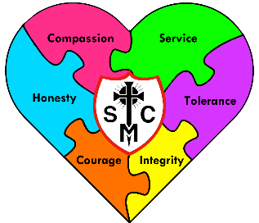


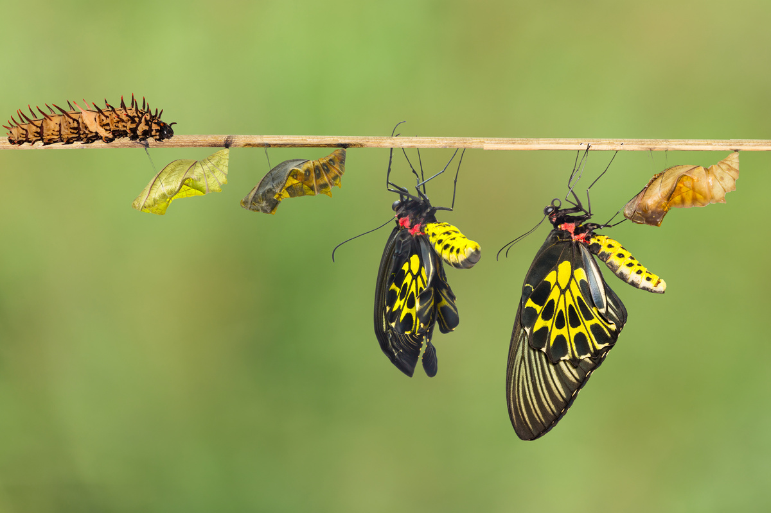







Year 4 Learning Overview
Advent Term 2
English
Maths
Science
We will be looking at:
  Applying our place value knowledge in column addition of 3 and 4 digit numbers
  Subtraction – in various ways – number line to column subtraction of 4 digit numbers and beyond.
  Multiplying 2 and 3 digit numbers
  Perimeter
  It is extremely important that children know their times tables by heart.
We are writing to inform and will be focusing on newspaper reports and description.
We will be:
Writing in paragraphs.
Using 5ws to give concise information in the first paragraph.
Including reported speech and using inverted commas for witness statements.
A narrative on outsiders
A report.
We are Scientists
We will be learning about organizing living things (plants and animals)by criteria
We will:
  Explain the things we observe.
  Investigate how different plants and animals can be sorted
  Identify the features of living things.
  Read and make tree and branch diagrams
We are reading...
The Whale
The Leaf
We will be developing our fluency, pace and stamina.
We will read 1:1 with an adult, small groups and daily guided reading sessions.
We will continue to work on fluency and expression.
RE
Prophecy and Promise
We begin with the topic ‘Promises’ where we will explore the importance and significance of the prophets and thir role in telling us what would happen in the future. We will link it with God giving us chances to be closer to Him.
Finally, we focus on the preparations we make as Christians to celebrate the birth of the Son of God.

Slide 2
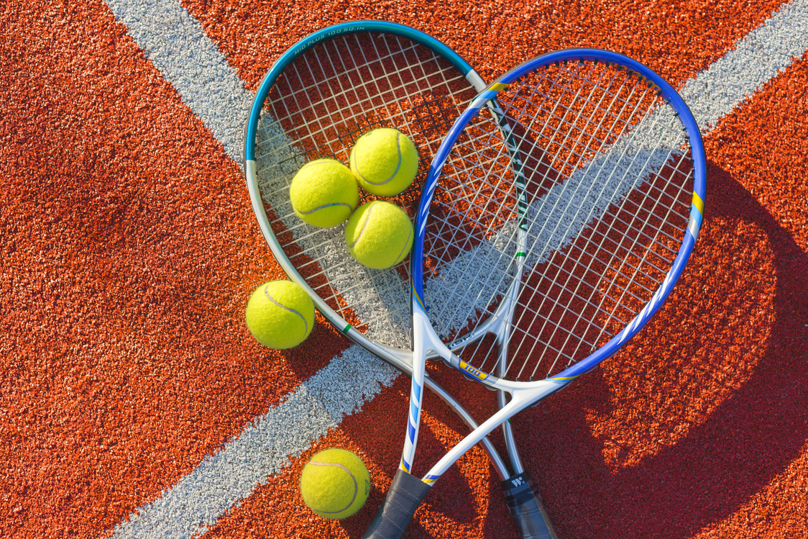





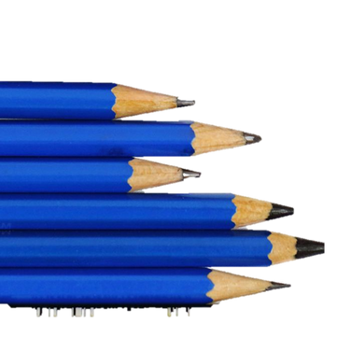
History
Music
PE
We are Historical Researchers.
We will be researching the Ancient Greeks and contrasting their civilization to Britain during the same time period. We will be discovering the impact the Ancient Greeks had on the world and their legacy.
We will be learning about:
  Where and when the Ancient Greeks lived.
  What made their civilization successful
  Using sources to find out about history
  Ancient Greek religion and beliefs
  The decline of the Ancient Greeks.
  Their legacy.
Our Music lessons will focus on keeping rhythms and recognising different styles and beats. We will sing along and repeat back to echo rhythms and help develop out timing. Children will then begin to play some instruments. . This will progress to pupils performing their learning within a group .
Gymnastics
To take off and land safel;y
To build up a routine
To hold a balance
To work alone
To work in pairs
To work in a small group
To perform
To evaluate
RSHE
Computing
Spanish
¿Qué Fecha Es Hoy? What is the date?
Months and days
Key events
Families and Relationships
We will be looking at respecting one another and knowing that following the Sacraments can help us to develop healthy relationships. We will also focus on the importance of forgiveness and reconciliation.
Programming
Coding
Scratch
Giving commands
Following procedures
Animation elements
Design Technology
Food technology
Following a recipe
Adapting a recipe
Planning a healthy meal

