Slide 1




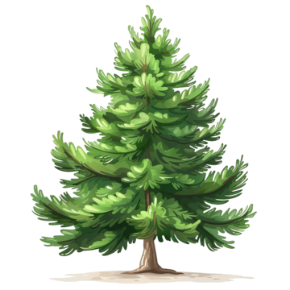








Year 1 Learning Overview
Advent Term 2
English
Maths
Science
We will be looking at:
Number bonds to 10
Subtracting using different methods
2D and 3D shapes
It is extremely important that children can now confidently count forwards and backwards to 20.
We will continue our study of the seasons and we will also begin our unit on Plants.
We will:
Observe and record the changes which take place through Autumn
Know the basic structure of a tree
Identify and name different types of trees (deciduous and evergreen)
Our text this term will be Rapunzel by Bethan Woollvin. Whilst reading and investigating this book we will be working towards writing our own traditional tale before then writing instructions on how to catch a witch.
Throughout the unit, we will be focusing on constructing sentences and using ‘and’ to make sentences longer. We will also be using the suffixes ‘s’ ‘es’ and ‘er’ and talking about how the words change. As always, ensuring we have finger spaces, capital letters and the correct very important.
We are reading...
In phonics, we will be recapping sounds we already know before beginning to grow the code and learn new sounds.
New sounds we have learnt will be sent home each week for you to continue to practice together at home.
RE
Prophecy and Promise
We will explore the Bible stories of The Annunciation, The Visitation, The Birth of Jesus and the Visit of the Shepherds. As we listen to these stories, we will think about the special people and why these stories are important for Catholics. We take a closer look at Mary, learning the words of her prayer and thinking about how Catholics around the world honour Mary.

Slide 2






History
Music
PE
As Historical Researchers, we will be finding out more into how toys have changed over the last 100 years. We will listen, ask questions and handle historical artefacts to help us to discover more facts!
We will be learning:
About toys we play with today
Different ways we can find out about toys from the past
Features of different toys
How to recognize old and new toys
About how toys have changed over time
Our PE specialist teachers will be focusing this term on the skills needed in Football. We will be developing our listening and team skills, whilst also gaining more control over a ball on the ground.
Our Music specialist teachers continue to come into Year 1 once a week. Their lessons this term will focus on two songs: Rhythm In The Way We Walk (Reggae style) and Banana Rap (Hip Hop style). We will Listen & Appraise other styles of music and continue to embed the interrelated dimensions of music through games and singing.
Art
RSHE
Computing
Drawing: Exploring Line and Shape
In this unit we will:
Connect lines to create shapes.
Use and recognise different types of lines when drawing shapes.
Identify basic shapes in everyday objects and artwork.
Talk about what we like or dislike in a piece of artwork.
Use shapes to draw a face.
Use different pressures to make a colour lighter or darker.
Choose lines and shapes inspired by Brianna McCarthy’s artwork.
We will be focusing on Internet Safety and the importance of staying safe online.
We will continue to become more confident using laptops and iPads. Our main aims are to:
Use computers for a specific purpose
Log in and navigate around a computer
Drag, drop, click and control a cursor using a mouse
Use software tools to create art on the computer
Created to Love Others
In this unit, we will identify the people we trust to talk to. We will be thinking about why saying sorry is important and how we feel when saying sorry. We will also think closely about our behavior and how our behavior can make others feel. Finally, we will think about safe and unsafe situations.

