Slide 1










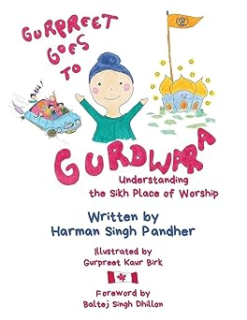
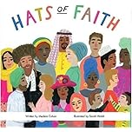
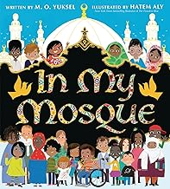
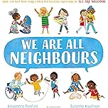






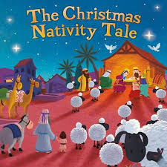
Nursery Learning Overview
We are reading...
Advent Term 2
Our topic is ‘We are all unique‘
English
Maths
RSHE
Our focus will be looking at how special and amazing we are and about the people who love and care for us. We will also be showing our kindness and love to others. In circle time we will be looking at the different of doing the right and wrong things and know that we will be forgiven if we understand that we have done wrong and know how to say sorry.
John 3:34 I give you a new command. Love each other.
You must love each other as I have loved you.
We will be looking at:
Number 1
Subitize to 2
Number 2
Pattern.
We will be understanding the five key concepts of print by learning the names of the different parts of a book.
In Writing we will be drawing freely.
In Phonics we will be using the Programme ‘Little Wandle to start to learn sounds s,a,t,p,i,n,m and playing phonics games in groups.
We will continue to do ‘Rhyme Time’ where we will play games that develop our:
Listening, Syllables, Rhyming, Alliteration and Sound Knowledge.
We are reading...
RE
This term, children in Nursery we will be learning about ‘Prophecy and Promise’. We will be learning about that Advent is a time to get ready for Christmas, the angel visited Mary with an important message, that Mary and Joseph travelled to Bethlehem, Jesus was born in the stable, the angels told the shepherds to visit Jesus and the shepherds visit the manger.

Slide 2






Understanding the World
Fine motor skills
PE
Copy a ready position to receive objects.
Push, roll and throw items over small distances with confidence.
Past and Present:
We will be learning that God made all natural things in the world..
People, Culture and Communities
We will be learning that there are differences between people and that God created us to be unique. We will also be learning that there are differences between what people believe. And know there are special places of worship.
The Natural World
We will be exploring through our sense the world around us and using growing vocabulary to describe what we experience.
We will be also talking about the differences between materials we work with and the changes we notice.
To begin to increase pressure when using tools.
To use the right resources to carry out their own plan.
Start taking part in group activities which they make up for themselves or in teams..
Expressive Ar t and Design
Communication and language
Gross Motor
Creating with Materials
Choose colours purposely
Begin to use objects to print or create patterns.
Begin to join boxes together using sticky tape or glue..
Being imaginative and expressive
Remember and sing entire songs
Respond to what they have heard expressing thoughts and feelings.
Sing the pitch of a tone sung by another person.
Sing the melodic shape of familiar songs.
Play instruments with increasing control to express their feelings and ideas.
Watch dances and performances.
Engage in pretend play: “putting the baby to sleep' or 'driving the car to the shops.'
Enjoy listening to and repeating rhymes.
Understand a question or instruction that has two parts, such as: "Put on your coat and wait at the door".
Begin to pay attention to more than one thing at a time.
.
Use large-muscle movements to wave flags and streamers, paint and make marks
Collaborate with others to manage large items, such as moving a long plank safely, carrying large hollow blocks.
Start taking part in some group activities which they make up for themselves, or in teams.

