Slide 1

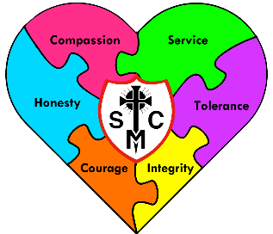






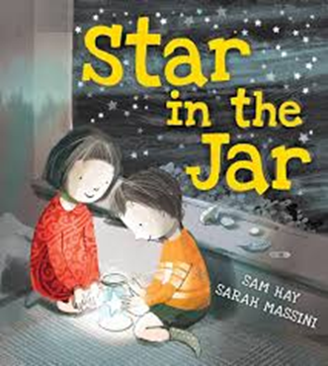



F2 Learning Overview
Advent Term 2
Understanding the World
Literacy
Maths
People, Culture and Communities:
Know that their community is made up of many different people with different roles.
Talk about some of the similarities and differences in family groups.
Know that unique means distinctive and your differences can make you unique.
Understand that some places are special to members of their community.
Recognise that people have different beliefs and celebrate special times in different ways.
Past and Present:
Know that God created us all to be like him but also unique.
Compare and contrast characters from stories, including figures from the past.
Word reading:
Read individual letters by saying the sounds for them.
Comprehension:
Retell stories related to event through acting/role play and images.
Create story maps and retell stories.
Sequence a story using the following vocabulary: beginning, middle and end.
Draw pictures of characters/ events/ settings in a story which may include labels, sentences, or captions.
Writing:
Write name correctly.
Begin to draw/write some of the main events of a story using initial sounds.
We will be looking at:
Identify, name and compare triangles and circles.
Find, subitise and represent numbers 1-5.
Automatically recall number bonds to 5.
Shapes with 4 sides.
We are reading...
Phonics
We follow the Little Wandle scheme.
Graphemes:
ff, ll, ss, j, v, w, x, y, z, qu, ch, sh, th, ng, nk and words ending with ‘s’.
Tricky words:
as, and, has, his, her, go, no, to, into, she, he, of, go, me, we, be.
RE
Prophecy and Promise
This term, children in EYFS will learn about The Nativity Story. They will know that Mary was chosen by God to be Jesus’ mother. The children will follow the journey
of Mary and Joseph and understand that the Nativity is a celebration of Jesus’ birth.
They will also know that Advent is a time to get ready for Christmas, help others and show our love to God.
By the end of the unit, all children will know that God sent Jesus to love us all.

Slide 2






PSED
Communication and Language
Physical Development
Self-Regulation:
Identify and moderate their own feelings socially and emotionally.
Express their feelings and consider the needs of others.
Enjoy a sense of belonging through being involved in daily tasks.
Managing Self:
Assert their own ideas.
Plan and complete an activity of their own choice independently.
Know right from wrong
Talk about why keeping healthy, both mentally and physically is important.
Manage their own personal hygiene needs.
Feed themselves with a fork and spoon.
Building Relationships:
Develop particular friendships with other children.
Take turns and share with others.
Listening:
Listen to familiar stories with increasing attention and recall.
Understand how to listen carefully and know why listening is important.
Engage with non-fiction books.
Speaking:
Describe events in some detail.
Join in with repeated refrains and anticipate key events and phrases in rhymes and stories.
Develop the use of social phrases e.g. to say hello without prompts from an adult.
Recite poems and rhymes confidently to a familiar audience.
Fine Motor Skills:
Develop their small motor skills so that they can use a range of tools competently, safely and confidently.
Manipulate a range of tools and equipment in one hand.
Gross Motor Skills:
Balance on one foot or in a squat momentarily, shifting body weight to improve stability.
Progress towards a more fluent style of moving, with developing control and grace
Further develop spatial awareness.
Expressive Arts and Design
Music
RSHE
Know the meaning of the word rhythm
Be able to clap rhythms by repeating
Begin to make up their own rhythms using words.
Begin singing in unison
Creating with Materials:
Join items in a variety of ways (sellotape, masking tape, string and split pins).
Being Imaginative and Expressive:
Watch and talk about dance and performance art, expressing feelings and responses.
Listen to music and say what they do or don’t like.
Sing a range of well-known nursery rhymes and songs.
Make music and move to music.
Created to Love Others
What is the internet?
Playing online
Safe inside and out
My body, my rules
Feeling poorly
People who help us
PE
Balance on one foot or in a squat momentarily, shifting body weight to improve stability.
Progress towards a more fluent style of moving, with developing control and grace
Further develop spatial awareness.

