Slide 1




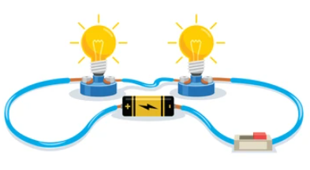








Year 6 Learning Overview
Advent Term 2
English
Maths
Science
We will:
Simplify fractions
Place Fractions on a number line
Compare and order fractions
Add and subtract fractions •
Mixed addition and subtraction
Multiply and divide fractions
Calculate fractions of an amount
It is extremely important that children know their times tables fluently in order to calculate with fractions.
We are Biologists
We will be studying Animals including Humans
We will:
Identify and name the main parts of the human circulatory system, and describe the functions of the heart, blood vessels and blood
Recognise the impact of diet, exercise, drugs and lifestyle on the way their bodies function
Describe the ways in which nutrients and water are transported within animals, including humans
We are writing a Diary Recount
We will be:
Understanding the vocabulary for formal and informal speech.
Continuing to explore synonyms and antonyms
Using colons and semi-colons.
Using dashes for parenthesis
Using question tags in relation to informal speech
Using vocabulary to convey a character’s feelings.
We are reading...
In Year 6, reading continues to focus on fluency, prosody, and deep comprehension. Pupils analyse complex texts, infer meaning, evaluate authors’ choices, and compare themes. Vocabulary knowledge expands, supporting precise understanding. This requires reading at home everyday to maintain progress.
RE
Prophecy and Promise
We will know there are significant women in the Old Testament who played important roles in God’s plan of salvation. Know that Mary, as the fulfilment of Old Testament promises, became the Mother of God by saying “yes” to His plan, and her Magnificat stands as a song of praise for both her and the Church. We will explore the Lucan and Matthean infancy narratives which each present unique perspectives on Jesus’ birth. We will reflect on how women continue to respond to God’s call reflecting on their vital and ongoing role in the life of the Church.

Slide 2



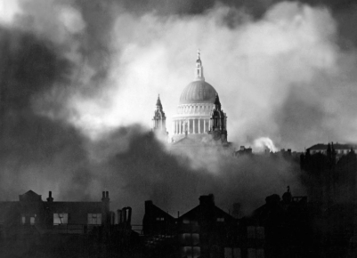
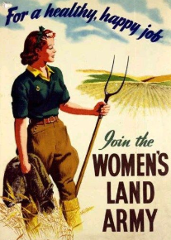



History
PE
Music
In football we will know :
That curve/swerve and lofting can be applied to a football depending on the point of contact.
That numerous formations exist in football. Some are more defensive and others more defensive.
A number of in game tactics can be applied to overcome opponents – whole team pressing systems are one.
We will understanding the changing roles of women as a result of WWII
We will be learning about:
The significant events which led to WWII
The causes and impact of Evacuation
The effects of the Blitz
The change in role of women in WWII
How women’s lives changed after the war
Scales
Explore scales and
chords. Sing as part of a choir
with a sense of ensemble and
performance.
Spanish
RSHE
Computing
We will:
Know the vocabulary for school subjects.
Know how to say what subjects they like and dislike at school.
Know how to tell the time in Spanish.
Know how to use the verb ‘ir’ in Spanish to say what time they go to school.
Created to Love others
We will be looking at:
How our thoughts and feelings impact others
Prejudice, bullying and discrimination
Acceptable and unacceptable types of contact
Effects of drugs, alcohol and tobacco on the body
Saying no to pressures from others
How the Primary Survey is used to save lives
Data Handling
Identify how barcodes and QR codes work
To recognise how RFID is used
To input and analyse real-world data
To analyse and evaluate transport data
DT
Electronic Systems
Research and analyse a range of childrens’ toys
Design a steady hand game
Construct a stable base
Assembly electronics and complete an electronic game

