Slide 1

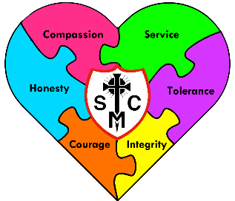

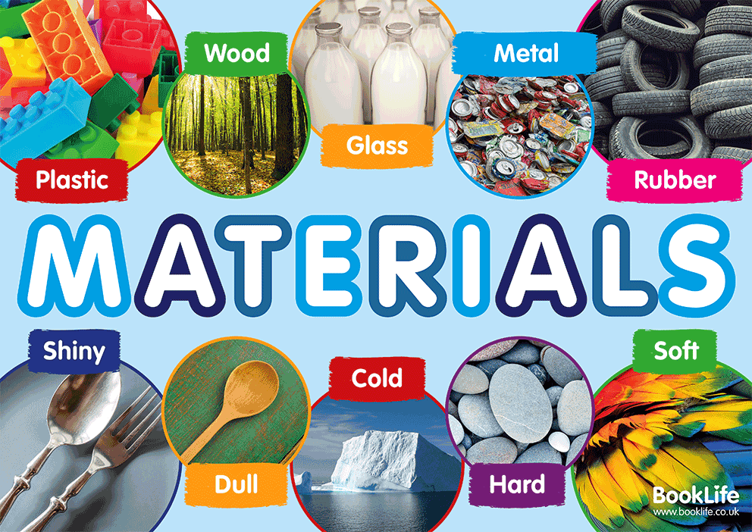









Year 5 Learning Overview
Lent Term 1
English
Maths
Science
This half term we will be finishing the statistics unit, focusing on interpreting line graphs, tables and timetables.
We will then continue to develop multiplication and division skills. Pupils will learn a range of formal methods for long multiplication and division. They will use these skills to solve problems and answer reasoning questions.
This half term, pupils will learn about different materials and their properties, such as hardness, flexibility, transparency, and conductivity. They explore how materials are suitable for different uses based on these properties and carry out investigations to test and compare materials. Pupils also think about how materials can be changed or combined for practical purposes and begin to understand how scientists and engineers choose materials to solve real-life problems.
In this unit, we will be
using Sherlock Holmes’ detective story to inspire us to write a Cliffhanger Narrative and a Formal Report . We will be focusing on expanding our vocabulary and applying this vocabulary to our own compositions. We will also be developing our understanding of what relative clauses are and how to use them effectively and learning how to using devices to build cohesion within a paragraph.
The text will be used alongside a Graphic Novel
to help us to find meaning and develop our comprehension skills.
We are reading...
We will continue to work through the Year 5 spelling rules. Spellings will be tested on a Monday every week
We will read 1:1 with an adult, and in daily guided reading sessions to develop our fluency, prosody and comprehension skills
RE
Galilee to Jerusalem
In this branch, pupils explore the “new law” given by Jesus, including the Beatitudes and his teaching on loving God and neighbour, which go beyond the old law of Moses. They learn about the Sermon on the Mount, where Jesus calls people to deeper happiness and wholeness in God, and reflect on parables such as the Good Samaritan to see love in action. Pupils also study the Transfiguration, where Jesus reveals his divine glory alongside Moses and Elijah, showing the link between the Law, the prophets, and the Messiah. The unit includes learning about the Our Father as the perfect prayer, which invites Christians into a close, family relationship with God and guides them in how to pray and live faithfully.

Slide 2
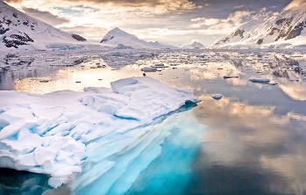




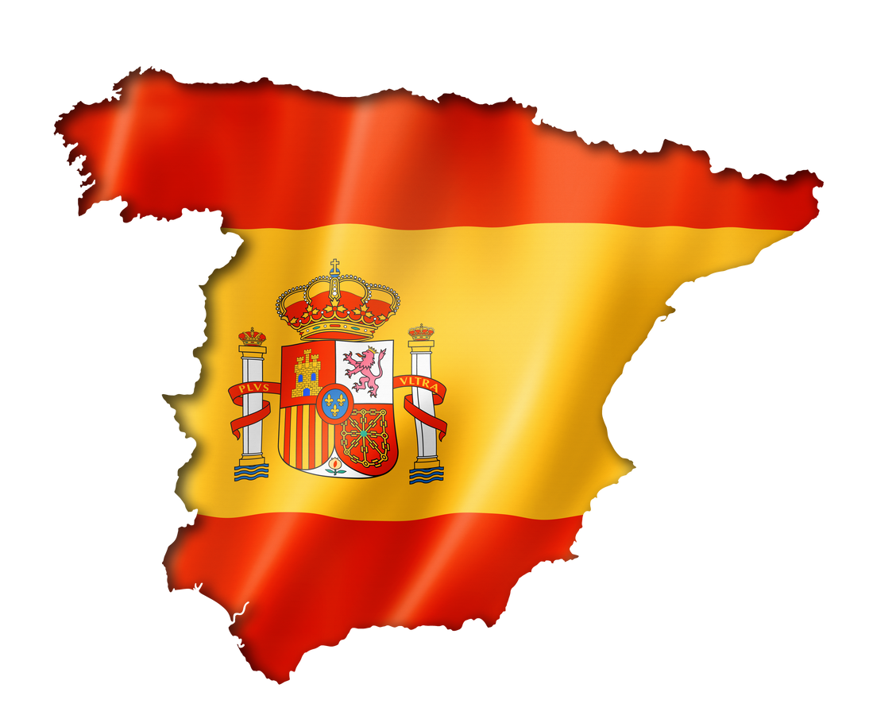
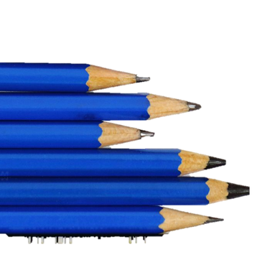
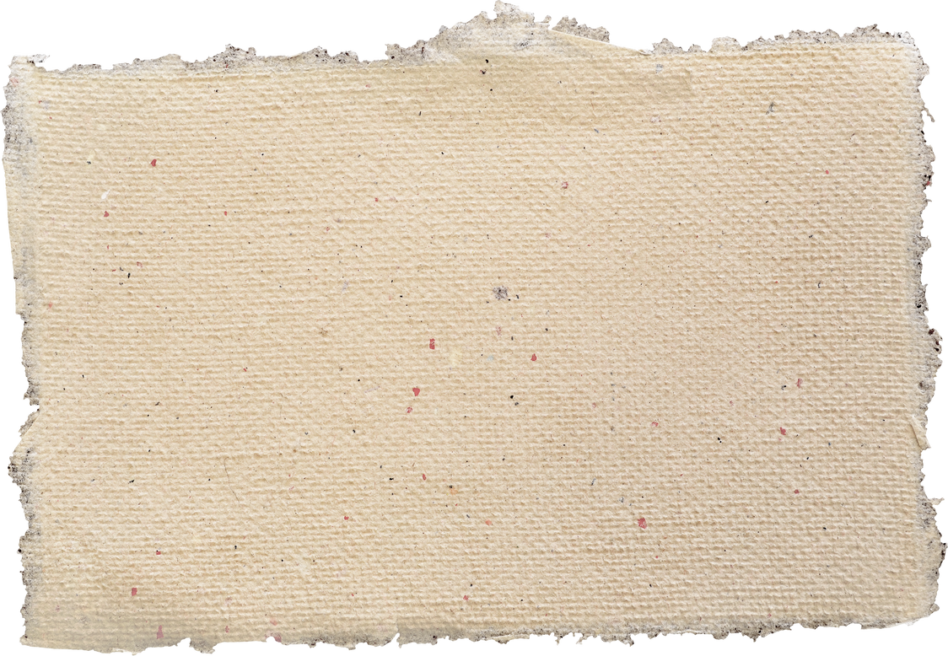
Music
PE
Geography
Dance
In this unit, pupils learn there are 5 main actions in dance: jump, turn, travel, gesture and stillness. They will then develop skills in being creative with movements, use transitions to link motifs smoothly, improvise within the sequence and use more complex dance vocabulary to compare and improve performance of self and group members.
Polar Biomes
In this topic, pupils learn about polar biomes, including the Arctic and Antarctic regions, and explore the extreme cold, ice, and snow that shape these environments. They study the plants and animals that are specially adapted to survive in these harsh conditions, such as polar bears, penguins, and mosses. Pupils also consider how people live and work in polar areas, how the climate affects life, and the impact of climate change on these fragile ecosystems.
Make you Feel my Love
In this unit, pupils will review their learning thinking about dynamics and time signatures. They will learn how to write a song understanding how chords are formed. They will work to create an accompaniment to their piece. They will be reviewing all prior learning to bring it all together in their final composition.
Spanish
RSHE
Computing
Pupils will learn the days of the week, months of the year and numbers up to 31 progressing to being able to say the date and when their birthday is in Spanish by the end of the unit.
Created to love others
Pupils will continue to focus on how we can take care of each other this topic and learn about the right to consent. We will also look at how to use technology safely and develop our understanding of what cyberbullying is. Once we have thought about care for others, we will consider the three persons of the Holy Spirit and the principles of Catholic Social Teaching so we can reflect on our roles to love in community.
Computing Systems and Networks:
In this unit, pupils learn how the Mars Rover collects different types of data from space and sends it back to Earth using binary code. They explore why scientists collect data from space and how it helps us understand other planets. Pupils also look at the computer architecture of the Rover, learning how information is stored and how binary code is used to manage different types of data for experiments and communication.
Art and DT
In this unit, pupils will explore how to create portraits using a variety of mixed media They will learn about proportions and features of the human face, experiment with texture, colour, and layering, and study examples of portrait art from different artists and cultures..

