Slide 1

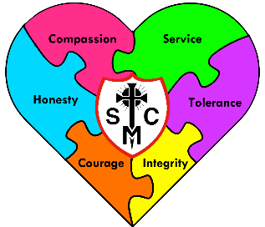


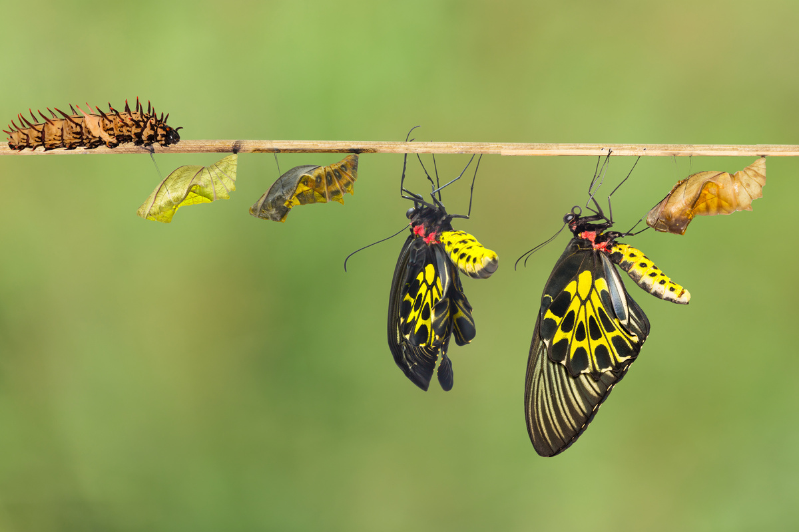







Year 4 Learning Overview
Lent Term1
English
Maths
Science
We will be looking at:
Multiplication facts
Multiplying numbers 2 and 3 digit numbers
Dividing - sharing exactly and with remainders
Perimeter
Fractions
It is extremely important that children know their times tables by heart.
We are writing to entertain as we plan and write our own myth.
We will be:
Writing a narrative as a legend or myth, inspired from the Viking link in our book, but then planning ours using our knowledge from the Ancient Greeks from last time to create our own Greek myth story.
Our stories will contain fronted adverbials, extended noun phrases
and ambitious vocabulary. Any speech will be well punctuated.
We are Scientists
We will be learning about States of Matter
We will:
Work independently, in pairs and in groups in this topic.
Learn about the three states of matter – liquids, solids and gases.
Make predictions and observations
Record results
Draw conclusions
Change the states of materials by heating or cooling
We are reading...
Arthur and The Golden Rope
We will be developing our fluency, pace and stamina.
We will read 1:1 with an adult, small groups and daily guided reading sessions.
We will continue to work on fluency and expression.
RE
We begin with the topic Galilee to Jerusalem. We will be reading form the Bible and showing some understanding of why some people gave Jesus the title Christ. We will make links between Jesus’ speech to the followers of John the Baptist and signs that Jesus is the Messiah. We will focus on the Nicene Creed and see how that links with Jesus as Messiah.
We will look at the Sacrament of Reconciliation and the Sacrament of the Sick. We will also look at how Jesus worked with people on the fringe of society and how the Kingdom of God is linked with Jesus’ miracles.

Slide 2
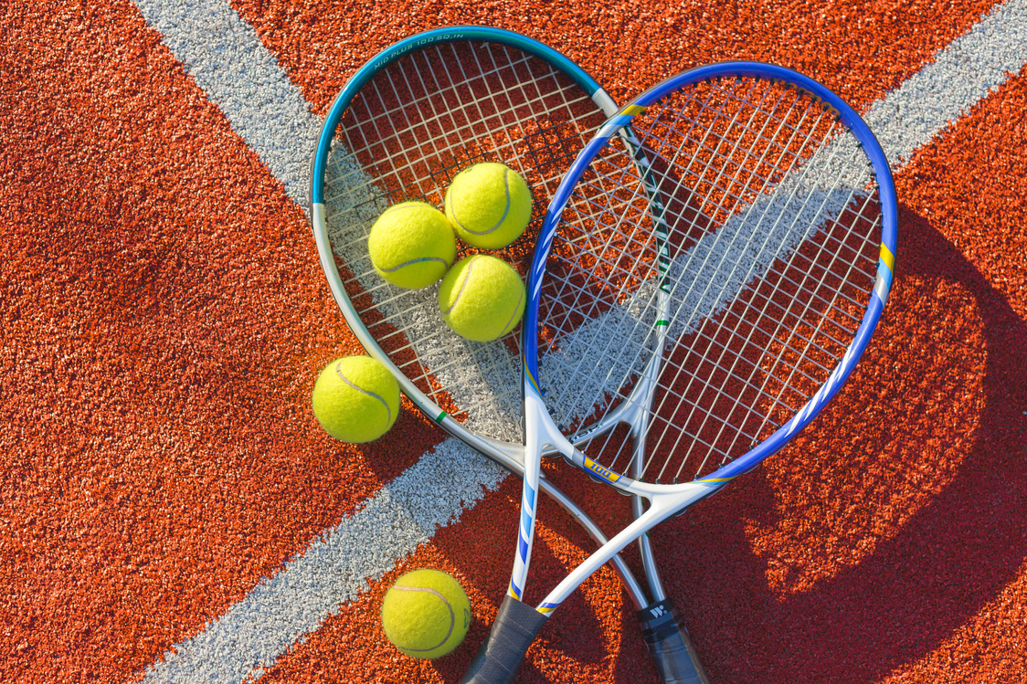






Geography
Music
PE
We are Historical Researchers.
We will be researching the Romans and seeing their effect in Britain, how they were welcomed or not!
We will be learning about:
Where, when and why the Romans invaded.
What made their civilization successful
Using sources to find out about history
Roman religion and beliefs
The decline of the Romans in Britain.
Their legacy.
Our Music lessons will focus on keeping rhythms and recognising different styles and beats. We will sing along and repeat back to echo rhythms and help develop out timing. Children will then begin to play some instruments. . This will progress to pupils performing their learning within a group . This term will see more writing of music and reading of scores.
Swimming at Southglade
We will learn water safety before we enter the pool.
We will learn front crawl stroke
We will learn how to swim on our back.
We will do water safety in the water, incase of accidents in a river for example and how to help others.
The aim is to swim 25metres on front and back by Easter.
RSHE
Computing
Spanish
Tudor History is the topic that children will be listening and reading for the gist of sentences and information in Spanish.
Families and Relationships
We will be looking at respecting one another and knowing that following the Sacraments can help us to develop healthy relationships. We will also focus on the importance of forgiveness and reconciliation. (A great link with the RE)
Writing for different audiences – adapting fonts and sizes, colours and borders.
Learning how to insert pictures into word documents
Improving the saving of our work, in an orderly fashion.
Animation
Design Technology
Plan a structure in the style of the ancient Greeks or Romans.
Use measuring skills
Use cutting skills.
Learn how to strengthen corners and joins.

