Slide 1

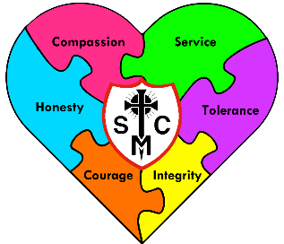


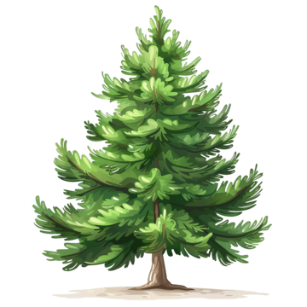








Year 1 Learning Overview
Lent Term 1
English
Maths
Science
We will be looking at:
Writing numbers to 20 using numerals and words
How to use a number line
Deepening our understanding of numbers to 20 before then moving up to 50
Adding and subtracting within 20
We will continue our study of Plants looking at the
parts of trees, different
types of trees and also
look closely at the parts
of plants too. We will conduct an experiment which looks at how plants grow by planting and caring for our very own.
We will also continue to observe and discuss the changes in the weather during our current season of Winter, comparing these to Autumn.
Our text this term will be Hermelin by Mini Grey. We will learn lots of new vocabulary, answer questions about the story and learn more about the characters through drama. We will then write our own version of the story before late writing a letter of our own to Hermelin. Whilst doing all this, we will also be improving our sentence skills by using question marks, exclamation marks, using ‘and’ to make sentences longer and also changing words using prefixes and suffixes.
We are reading...
In phonics, we are continuing to develop our knowledge of the sounds and apply these to spelling. Please continue to help your child learn the weekly spellings as it really does help them to embed the phonics rules we have learnt.
RE
Galilee To Jerusalem
We will explore the Bible stories of The Presentation, Jesus in the Temple, The call of the Disciples, Zaccheaus and Jesus’ mission. Through these stories, we will think about Jesus as he is growing and learn more about when he did when he to help others see the right way to live.

Slide 2
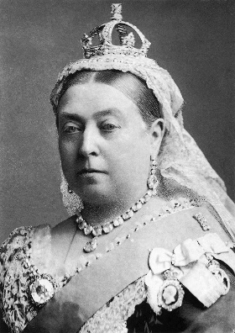




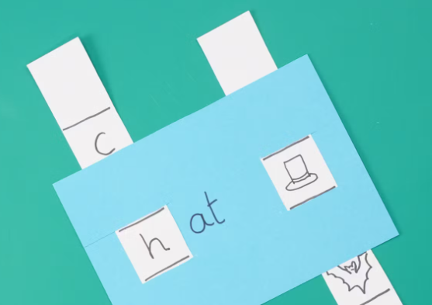
History
Music
PE
As Historical Researchers, we
will be discovering more about
Kings and Queens, both past
and present.
We will be learning:
What a monarch is
Who our current monarch is
About the time England had no monarch
Why Queen Victoria was a significant monarch
Which other monarchs were significant in British history
Our PE specialist teachers will be continue to build our multi skills such as listening, resilience, balance, strength, coordination and team work through a unit of movement and dance.
Our Music specialist teachers continue to come into Year 1 once a week. Their lessons this term will focus different styles of music. Through the song ‘In the Groove’ the children will hear it played in many styles; Blues, Baroque, Latin, Bhangra, Folk and Funk.
D&T
RSHE
Computing
Mechanisms: Matching Slider Game
During this unit we will:
Identify slider mechanisms and think about how they work
Make our own slider mechanisms and try to make them better
Design a slider game using others as a guide
Make our own slider game using tools with increased accuracy
Test our product out and evaluate it!
We will continue to remind the children the importance of Internet Safety and staying safe online.
We will begin our unit on Algorithms, in which we will learn:
What an algorithm is
How to write an algorithm
How to follow an algorithm
Create an achievable programme by using small steps
Identify bugs in an algorithm and know how to fix them
Created to Live in Community
In this unit, we will gain more understanding of God as the Trinity. We will also be thinking about who our neighbours are and how we should treat them. We will then think about some of the communities we live in and why these are important to us.

