Slide 1









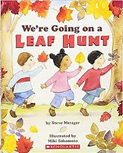
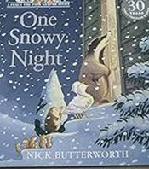


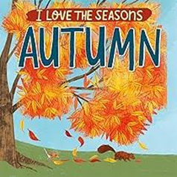






We are reading...
Nursery Learning Overview
Lent Term 1
Our topic is ‘Changing Seasons’
English
Maths
RSHE
We will be looking at:
  Subitising 3
  Number 3
  Number 4 and it’s composition
  Number 5 and it’s composition
Our focus will be on how we should love each other and ways in which we can show it to each other, including our family, school friends, church and people who help us in the community.
We will be listening to stories including: the feeding of the five thousand to help us understand how important it to care for each other.
We will be learning about the sign of the cross, The Holy Trinity, and what it means to Christians.
We will be exploring books independently and engaging in extended conversations about stories, learning new vocabulary. In Writing we will be Sometimes give meaning to our drawings and paintings .
In Phonics we will be using the Programme ‘Little Wandle to start to learn sounds d, g, o, c, k, e. and playing phonics games in groups.
We will continue to do ‘Rhyme Time’ where we will play games that develop our:
Listening, Syllables, Rhyming, Alliteration and Sound Knowledge.
Created to Love in the Community
We are reading...
RE
This term, children in Nursery we will be learning about ‘Galilee to Jerusalem’ we will be learning about the Kings visiting Jesus, that they brought him gifts, that Jesus welcomes everybody, Jesus takes care of everybody, Jesus wants us to care for other people and Jesus teaches us to share what we have with others.

Slide 2





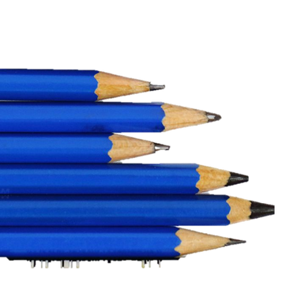
Understanding the World
Fine motor skills
PE
We will be learning to move confidently and safely in our own and general space.
We will be learning to jump and land upwards or downwards from a stationary position.
The Natural World
We will be understanding that the weather changes and in different places you find different weather.
We will be exploring how the different weather types affect the natural environment and materials.
We will be exploring and talking about collections of materials with similar and/or different properties.
We will be able to identify suitable clothing for different weather.
We will know there are hot and cold places in the world (including countries).
We will be talking about the differences between materials used in their clothes and changes they notice.
show an increasing desire to be independent e.g. do up my own zip and buttons. Please practice this at home.
use playdough to create a body of a snake, with support.
Expressive Ar t and Design
Communication and language
Gross Motor
Creating with Materials
Explore different materials freely, in order to develop my ideas about how to use them and what to make.
Being imaginative and expressive
Create own songs or improvise a song around one they know.
Name a variety of instruments.
Use construction toys to make settings.
Use their own experiences to develop storylines e.g. going on a bus/car ride.
Begin to understand “what “and “who” questions.
Listen to longer stories and remember most of what happens.
Start a conversation with an adult or a friend.
Begin to ask relevant questions.
.
We will be continuing to develop our movement, balancing, riding (scooters, trikes and bikes) and ball skills.
We will be filling buckets with water and carefully pouring into different containers.
We will have different sized buckets and different sized containers so we can fill them without spilling.

