Slide 1

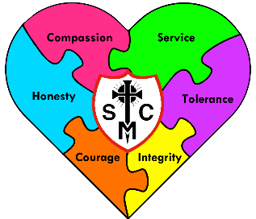










F2 Learning Overview
Spring Term 1
Understanding the World
Literacy
Maths
We are reading...
We will be looking at:
Find, subitise and represent numbers 0-8.
Automatically recall number bonds to 5.
Compare mass and capacity.
Find and make doubles to 8.
Make pairs odd and even.
The Natural World:
  Know the names of the four seasons.
  Know the ‘typical’ type of weather for each season.
  understand the effect of changing seasons on the natural world around them. E.g. seasonal changes to trees/plants; very cold weather can cause water to freeze, warmer weather will cause ice to melt.
  Explore the natural world around them.
  Describe what they see, hear and feel whilst outside.
  Use a wide topic vocabulary to describe what they experience with their senses.
Word reading:
Blend sounds into words, so that they can read short words made up of known letter-sound correspondences
Read simple phrases and sentences made up of words with known letter– sound correspondences and, where necessary, a few exception words.
Read some letter groups that each represent one sound and say sounds for them.
Comprehension:
Explain the main events of a story and give simple descriptions of characters.
Ask and answer questions about story book characters.
Distinguish between capital letters and lower- case letters.
Writing:
Begin to write simple phrases inspired by stories.
Spell words by identifying the sounds and then writing the sound with letter/s.
Phonics
We follow the Little Wandle scheme.
Graphemes: Phase 3
ai,ee,igh,oa,,oo,oo,ar,or,ur,ow,oi,ear,air,er.
Double letters and longer words.
Tricky words:
Are, sure, pure, into, she, he, we, me, be, of, my, by, all, was, you, they.
RE
Galilee to Jerusalem
This term, children in EYFS will learn about Jesus’ journey from Galilee to Jerusalem. They will know that the Wise Men visited Jesus and gave him special gifts. The children will learn that Jesus welcomes and takes care of everyone. They will also understand that Jesus teaches us to care for others and to share what we have. By the end of the unit, all children will know that Jesus wants us to love, help, and include everyone.

Slide 2




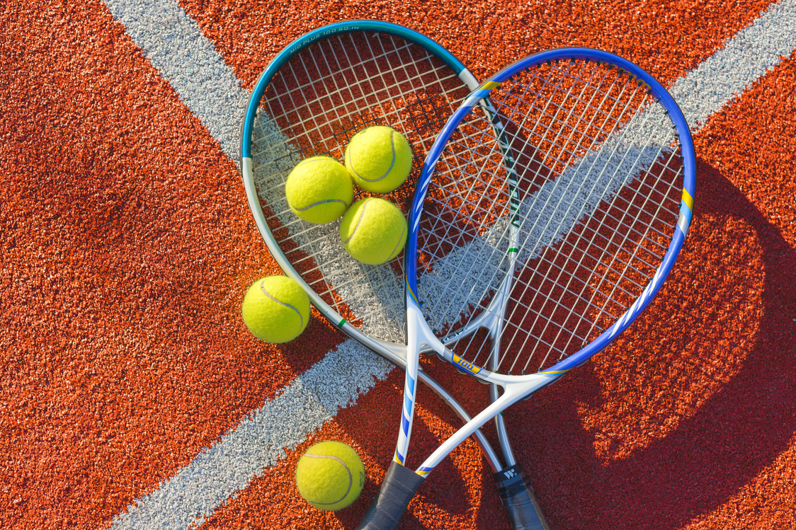

PSED
Physical Development
Communication and Language
Self-Regulation:
Be proactive in seeking adult support to find compromises.
Be increasingly flexible and co-operative.
express a wide range of feelings in my interactions.
Adapt their behaviour to different situations
Managing Self:
Show confidence in choosing resources and perseverance in carrying out a chosen activity.
Know right from wrong and try to behave accordingly.
Choose a healthy snack
Talk about how to keep their body healthy.
Learn good dental hygiene and know why it is important
Building Relationships:
Know what they and others need..
Fine Motor Skills:
Use a pencil and hold it effectively to form recognisable letters, most of which are correctly formed.
Gross motor skills:
Combine different movements with ease and fluency.
Confidently and safely use a range of large and small apparatus indoors and outside, alone and in a group.
Develop overall body-strength, balance, co-ordination and agility.
Further develop and refine a range of ball skills including: throwing, catching, kicking, passing, batting, and aiming.
Listening:
Respond to instructions with more elements.
Listen to and talk about stories to build familiarity and understanding.
Recognise the difference between fiction and non-fiction stories.
Speaking:
Ask questions to find out more and to check they understand what has been said to them.
Introduce a storyline or narrative into play.
Learn new vocabulary.
Expressive Arts and Design
Music
RSHE
To be able to “rap” nursery rhymes.
Copy rhythms on tuned instruments
Creating with Materials:
Know how to Improve models (scrunch, twist, fold, bend, roll).
Know how to secure boxes, kitchen rolls, decorate bottles.
Being Imaginative and Expressive:
Invent, adapt, and recount narratives and stories with peers and my teacher.
Make use of props and materials when role playing characters in narratives and stories.
Created to Live in Community
When I grow up
Classroom shorts – Who do you want to be?
Money doesn’t grow on trees
Classroom shorts – Chocolate bar.
PE
Sending and receiving:
I can use my body to move objects or items.
I can position myself body and hands to be better able to receive balls or bean bags.

