Slide 1













Year 6 Learning Overview
Lent Term 1
English
Maths
Science
We will:
Know the value of decimals numbers to 3dp
x 10, 100, 1000
÷ 10, 100, 1000
x decimals by integers
÷ decimals by integers
Convert between fractions, decimals and percentages
Calculate percentages of amounts
It is extremely important that children know their times tables fluently in order to calculate with decimals and percentages.
We are writing a Bravery Award Speech
We will be:
Understanding the vocabulary for formal and informal speech.
Understanding the passive voice to affect the presentation of information.
Continuing to explore new vocabulary through synonyms and antonyms
Using dashes and commas to indicate parenthesis.
We are reading...
We are Physicists
We will be studying Light
We will:
Recognise that light appears to travel in straight lines
Explain that objects are seen because they give out or reflect light into the eye
Explain that we see things because light travels from light sources to our eyes or from light sources to objects and then to our eyes
Use the idea that light travels in straight lines to explain why shadows have the same shape as the objects that cast them
In Year 6, reading continues to focus on fluency, prosody, and deep comprehension. Pupils analyse complex texts, infer meaning, evaluate authors’ choices, and compare themes. Vocabulary knowledge expands, supporting precise understanding. This requires reading at home everyday to maintain progress.
RE
Galilee to Jerusalem
In this branch pupils will learn about the life of Jesus and his revelation of the Kingdom of God through parables, encounters, miracles, and teachings. We will learn about the call of the disciples and the nature of being a follower of Jesus.
This will include exploring a range of miracles, knowing and understanding the sacraments. Understanding that the sacraments are meeting points with
God that bring people into a closer relationship with God and the community of
the Church.

Slide 2



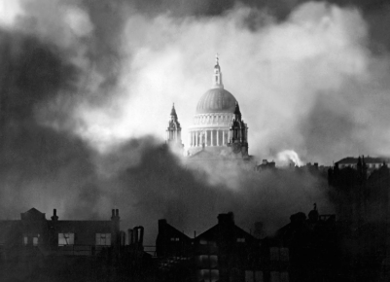




History
PE
Music
We will continue to understand the changing roles of women as a result of WWII
We will continue with our learning about:
The significant events which led to WWII
The causes and impact of Evacuation
The effects of the Blitz
The change in role of women in WWII
How women’s lives changed after the war
Play in an Ensemble
Read and perform from rhythm notation in up to four parts,
identifying note names, expanding on known rhythm notation.
In Dance we will know :
It is possible to communicate a message through dance using principles such as isolation, tempo, and repetition.
Posture and poise is important whilst dancing and movements should be clean and upright.
Spanish
Computing
La Segunda Guerra Mundial (World War 2)
Pupils will be taught the skills to understand longer and more complicated text in the foreign language.
Pupils will learn to ‘gist’ read, listen and understand more of the foreign language by using cognates and language they are familiar with so as to decode unknown language.
RSHE
Data Handling
To identify how barcodes and QR codes work
To recognise how RFID is used
To input and analyse data.
To analyse and evaluate data
Created to Love in Community
We will be looking at:
How to apply Catholic Social Teaching to current issues
Know the process of getting a job and factors that influence job choice
Know the hierarchy of needs in regards to spending
DT
Mechanical Systems: Cams and Followers
To prepare wood for assembly by measuring, marking and cutting each piece
To assemble the automata frame components and supports with the help of an exploded-diagram
To explore the relationship between cam profiles and follower movement, to inform a design decision
To apply the housing and finishing touches to the automata frame

