Slide 1




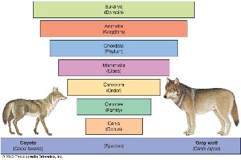








Year 6 Learning Overview
Lent Term 2
English
Maths
Science
We will:
  Solve problems involving percentages
  Convert between units of measure including solving problems in this context
  Calculate the area and perimeter of shapes
  Find the area of triangles and parallelograms
  Calculate the volume of shapes
  It is extremely important that children know their times tables fluently in order to calculate with decimals and percentages.
We are writing a Documentary Narrative and a Balanced Argument
We will be:
  Using expanded noun phrases to describe concisely
  Using adverbials for cohesion
  Semi-colons and dashes to mark boundaries between clauses
  Using the passive and subjunctive from in formal writing
  Using semi-colons in a list
  We will edit and publish
  our final pieces.
We are reading...
We are Biologists
We will be studying Living Things and their Habitats
We will:
Describe how living things are classified into broad groups according to common observable characteristics and based on similarities and differences, including micro-organisms, plants and animals
Give reasons for classifying plants and animals based on specific characteristics
In Year 6, reading continues to focus on fluency, prosody, and deep comprehension. Pupils analyse complex texts, infer meaning, evaluate authors’ choices, and compare themes. Vocabulary knowledge expands, supporting precise understanding. This requires reading at home everyday to maintain progress.
RE
Desert to Garden
In this unit, Year 6 pupils deepen their understanding of Holy Week through John’s Gospel, exploring how key texts reveal Jesus as the Messiah. They learn how Jesus shows love and service to all through the washing of the disciples’ feet on Holy Thursday and his sacrifice on Good Friday, making links with what Christians celebrate at Mass. Pupils also explore how the Crucifixion is reflected in the Stations of the Cross as a form of prayer, helping them understand how Christians remember and respond to Jesus’ journey to the cross.

Slide 2



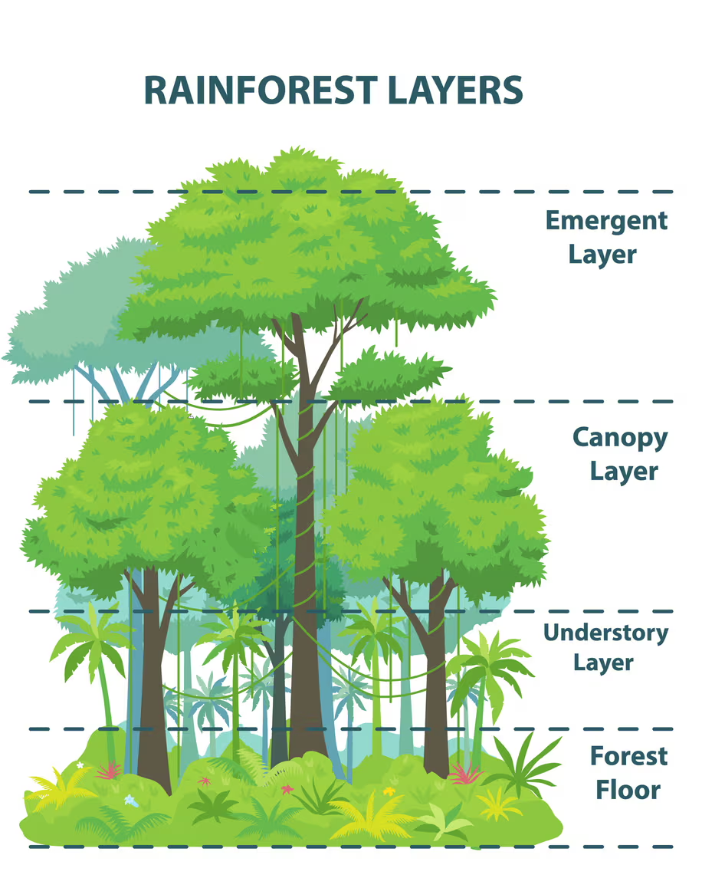



Geography
PE
Music
In Football we will know how :
To apply tactics to increase chances of success when attacking and defending.
To shoot with increased accuracy bypassing defenders.
To apply basic principles suitable for attacking and defending in different contexts.
Our topic will be Rainforest where will:
•Recap Biome knowledge
•Know the names of, and locate, a number of South American countries.
•Know the layers of a rainforest
•Know the impact of industrialisation on Brazil’s natural resources and know what deforestation is.
•Know the types of vegetation belts found in the rainforest.
•Know about time zones
Samba Music
Further develop an understanding of syncopated rhythms
Spanish
Computing
La Segunda Guerra Mundial (World War 2)
We will continue with our WWII topic where Pupils will be taught the skills to understand longer and more complicated text in the foreign language.
Pupils will learn to ‘gist’ read, listen and understand more of the foreign language by using cognates and language they are familiar with so as to decode unknown language.
RSHE
Programming
In programming we will:
Tinker with a new pieces of software
Understand nested loops
Understand basic python commands
Use loops when programming
British Values
We will be learning:
To know what democracy is and why it matters
To know why we have the rule of law and explore it’s purpose
I can explore the right to freedom and individual liberty
To know we must show tolerance and mutual respect for diversity
Art
Painting and Mixed Media
Analyse a famous painting
Find meaning in a painting
To analyse and respond to an abstract painting
Know how art and tell stories
Develop starting points
Understand painting techniques to make personal choices

