Slide 1












F2 Learning Overview
Lent 2
Understanding the World
Literacy
Maths
We are reading...
Word reading:
Read a few common exception words matched to the school’s phonic programme.
Comprehension:
Retell a story with actions and or picture prompts as part of a group.
Use story language when acting out a narrative.
Re-read these books to build up their confidence in word reading, their fluency and their understanding and enjoyment
Writing:
Create my own story maps, writing captions and labels, using short simple sentences.
Form lower-case and capital letters correctly.
Write short sentences with words with known letter-sound correspondence using a capital letter and full stop.
Write and use some of the tricky words such as I and The.
Re-read what they have written to check that it makes sense.
The Natural World:
Talk about some similarities and differences between life in this country and life in other countries, drawing on knowledge from stories, non-fiction texts and when appropriate – maps
The Natural World:
Explore the natural world around them and talk about the different plant/animal life that exists.
Describe what they see, hear and feel whilst outside.
Recognise some environments that are different to the one in which they live.
Understand the effect of changing seasons on the natural world around the world e.g. very hot/cold countries and how the plant and animal life differs.
We will be looking at:
Length, height and time.
Find and represent numbers 9 and 10.
1 more and 1 less to 10.
Number bonds to 10.
Doubles to 10
Explore even and odd numbers.
Phonics
We follow the Little Wandle scheme.
Graphemes: Phase 3
ai,ee,igh,oa,,oo,oo,ar,or,ur,ow,oi,ear,air,er.
Double letters, longer words, compound words.
Tricky words:
The, I, go, no, of, and, to, into, she, he, we, be, was, you, they, all, my, by, are, sure, pure.
RE
Desert to Garden
This half term in RE, the children will be learning about Lent and why it is a special time in the Church year. They will understand that Lent is a time to get ready for Easter, to grow closer to Jesus, and to care for others through kindness and good choices. The children will learn about Palm Sunday and how Jesus came to Jerusalem riding on a donkey, as well as Good Friday, when Jesus died on the cross and it is a sad time. They will also learn the joyful message of Easter Sunday, when God gave Jesus new life.

Slide 2



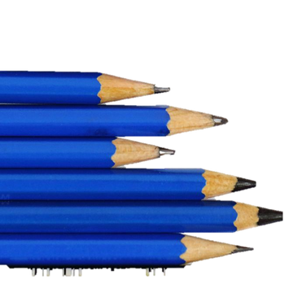


PSED
Communication and Language
Physical Development
Self-regulation:
Talk to others, include them in play and are willing to try new things.
Be able to manage their feelings and tolerate situations in which their wishes cannot be met.
See themselves as valuable individuals.
Give attention to what the teacher says, responding appropriately even when engaged in activity.
Managing self:
Know what they want to do in their play and how they want to go about it.
Show independence, and perseverance in the face of challenge not necessarily of their choosing.
Building relationships:
Usually play cooperatively and take turns with others.
Know that other children may have a different likes and dislikes.
Listening:
Listen to and talk about selected non-fiction to develop a deep familiarity with new knowledge and vocabulary.
Listen and respond to ideas expressed by others in conversations or discussions.
Speaking:
Extend their vocabulary, using it throughout the day.
Use new vocabulary in different contexts.
Connect one idea or action to another using a range of conjunctions.
Use talk to help work out problems and organise thinking and activities explaining how things work and why things might happen.
Articulate their ideas and thoughts in well-formed sentences.
Fine Motor Skills:
Use a pencil and hold it effectively to form recognisable letters, most of which are correctly formed.
Gross Motor Skills:
Develop confidence, competence, precision and accuracy when engaging in activities that involve use of equipment e.g. A ball.
Climb stairs, steps and move across climbing equipment using alternate feet.
Walk down steps or slopes whilst carrying a small object, maintaining balance and stability.
Expressive Arts and Design
RSHE
PE
Creating with Materials:
Independently select additional tools (stamps, rollers etc.) to improve my painting.
Create patterns or meaningful pictures when printing.
Explore, use and refine a variety of artistic effects to express their ideas and feelings.
Return to and build on my previous learning, refining ideas and developing ability to represent them.
Create collaboratively sharing ideas, resources and skills
Being Imaginative and Expressive:
Develop storylines in pretend play.
Listen attentively, move to, and talk about music, expressing feelings and responses.
British Values
Fairness and Opinions
Belonging
Uniqueness
Welcoming others
Movement to music
I can move man different body parts in different directions at different speeds.
Dancing is movement and can be done with or without music.

