Slide 1

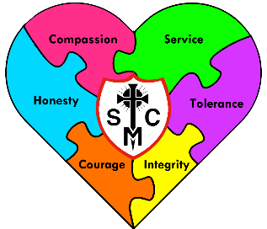


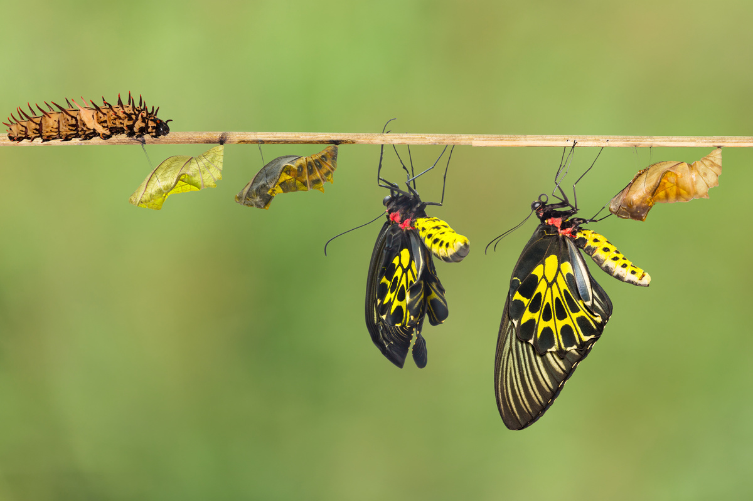







Year 4 Learning Overview
Lent Term 2
English
Maths
Science
We will be looking at:
Dividing - sharing exactly and with remainders
Perimeter
Fractions
It is extremely important that children know their times tables by heart.
We are writing to entertain as we plan and write our own outsider narrative.
We will be:
Writing a narrative with a twisted ending. Our stories will contain fronted adverbials, extended noun phrases
and ambitious vocabulary. Any speech will be well punctuated.
Secondly, we shall be writing a persuasive letter. We will learn how to set out a letter and be using persuasive language.
We are Scientists
We will be continuing our learning about States of Matter
We will:
Work independently, in pairs and in groups in this topic.
Learn about the water cycle.
Reversible and irreversible changes
Make predictions and observations
Record results
Draw conclusions
Change the states of materials by heating or cooling
We are reading...
The Lost Happy Endings
We will be developing our fluency, pace and stamina.
We will read 1:1 with an adult, small groups and daily whole class reading sessions.
We will continue to work on fluency and expression, as well as building up our vocabulary.
We also read for pleasure.
RE
Branch 4: Desert to Garden
In this branch, we will explore Lent’s themes of forgiveness and reconciliation and reflect on the stories of Holy Week in St Matthew’s Gospel. We link it with how Christ inspires Christians still.
We shall also be leading The Stations of the Cross in school and retelling the Easter story

Slide 2
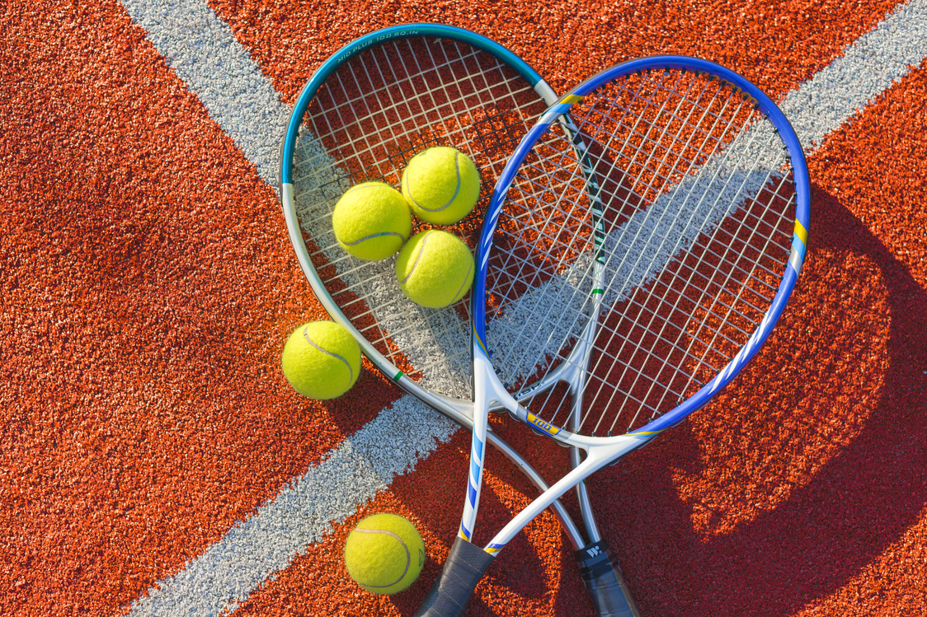






Geography
Music
PE
As budding Geographers
We will be learning about:
The main rivers in the UK.
Major rivers across the world.
Where rivers start – source
How to measure the length of a river
The journey of a river
Features of rivers
The environmental changes that affect rivers
River pollution
The water cycle
Our Music lessons will focus on keeping rhythms and recognising different styles and beats. We will sing along and repeat back to echo rhythms and help develop out timing. Children will then begin to play some instruments. . This will progress to pupils performing their learning within a group . This term will see more writing of music and reading of scores.
Swimming at Southglade
We will build on progress in the water.
We will learn front crawl stroke
We will learn how to swim on our back.
We will do water safety in the water, incase of accidents in a river for example and how to help others.
The aim is to swim 25metres on front and back by Easter.
RSHE
Computing
Spanish
Families and Relationships
We will be looking at respecting others
Consent – having responsibilities and choices
British values
Investigating weather
Which is a good link with the science work on states of matter and temperature.
Computational thinking
As always we will be aware of internet safety and know what to do if something unsafe comes up.
The weather
Art
Light and dark with shading in pencil and experimenting with paint techniques, including
Pointillism
shadows

