Slide 1

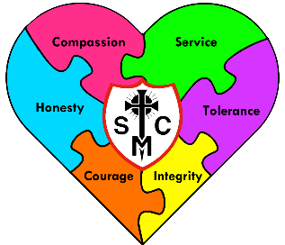


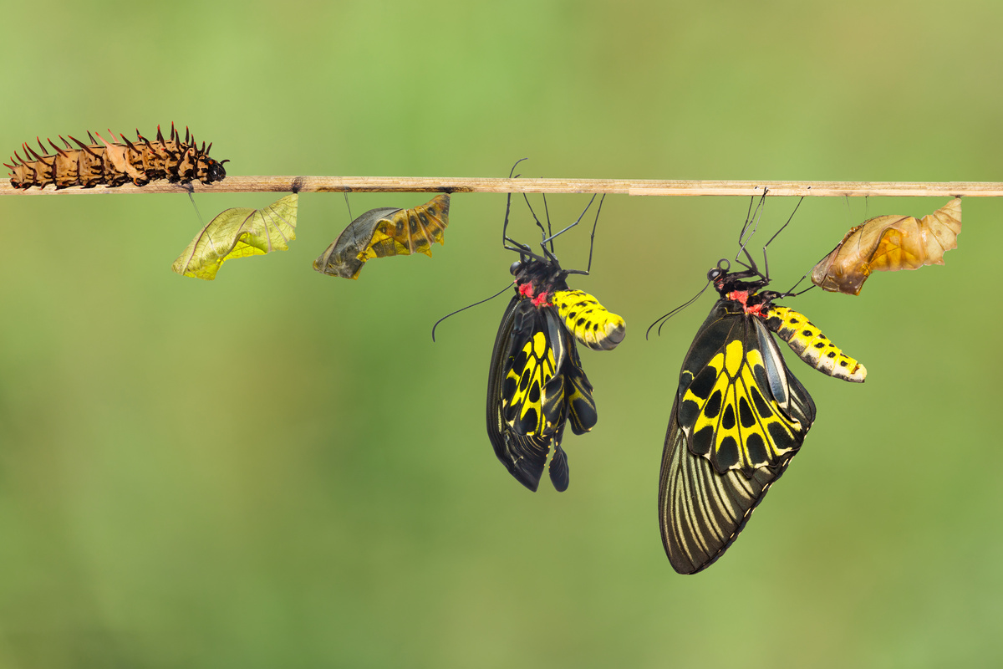







Year 4 Learning Overview
Pentecost Term 1
English
Maths
Science
We will be looking at:
  Equivalent fractions
  Counting below zero
  Decimals
  Money
  It is extremely important that children know their times tables by heart.
We are writing to entertain as we plan and write our own story.
We will be:
Writing a narrative about an outsider, someone who does not seem to belong or is new to an area.
Our stories will contain fronted adverbials, extended noun phrases
and ambitious vocabulary. Any speech will be well punctuated.
Our use of apostrophes should be more accurate now.
We are Scientists
We will be continuing our learning about States of Matter
We will:
Work independently, in pairs and in groups in this topic.
Make predictions and observations
Record results
Draw conclusions
Change the states of materials by heating or cooling
We move onto sound – pitch and volume
Sound waves and vibrations
We are reading...
The Journey
We will be developing our fluency, pace and stamina.
We will read 1:1 with an adult, small groups and daily guided reading sessions.
We will continue to work on fluency and expression.
RE
To The Ends of the Earth
In this topic we explore the importance of the Resurrection and the global effect of Christianity. We follow the stories that happened after Jesus’ resurrection, his ascension and make links about how we can be disciples still. It leads us to Pentecost and the significance it has and how we can be living out our faith.

Slide 2
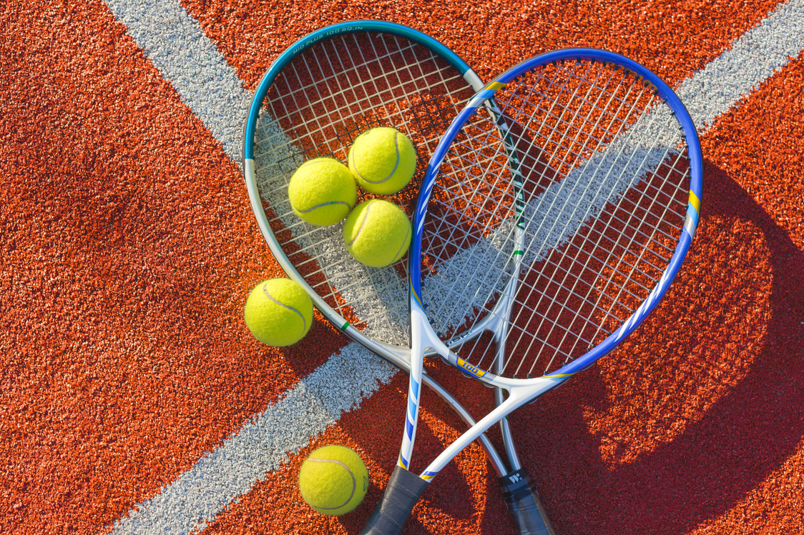




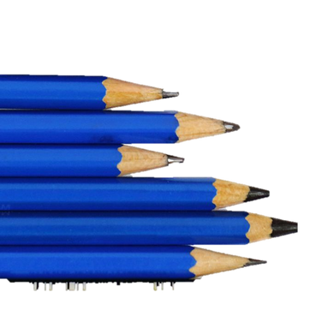
Geography
Music
PE
We are geographers comparing a place in Poland – Krakow with a place in England Nottingham.
We shall look at maps
We will draw on our first hand experiences and knowledge
We will look for similarities and differences between the two European places.
Our Music lessons, on Friday afternoons, will focus on keeping rhythms and recognising different styles and beats. We will sing along and repeat back to echo rhythms and help develop out timing. Children will then begin to play some instruments. . This will progress to pupils performing their learning within a group . This term will see more writing of music and reading of scores.
We will be focussing on athletics this half term.
Throwing
Running
Jumping
Measuring distances and speeds
Improving techniques
Preparing skills for Sports Day
RSHE
Computing
Art
Looking at sculptures
Creating sculptures from recycling materials. Trying to get strength and form
Families and Relationships
We will be looking at respecting one another alongside British values.
This is supported by our school behavior and virtues.
We will also see how growing up can make changes to ourselves and our choices.
Trying to follow a sequence of commands
Skills of building up a sequence or game
Using IT across the curriculum.
The Multiplication Check will be using a laptop, in a similar style to TTRS soundtrack.
Design Technology
Plan a structure in the style of the ancient Greeks or Romans.
Use measuring skills
Use cutting skills.
Learn how to strengthen corners and joins.

