Slide 1

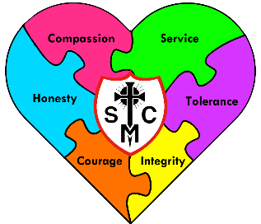


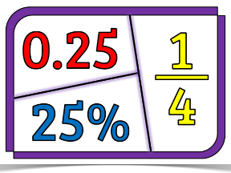

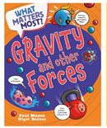
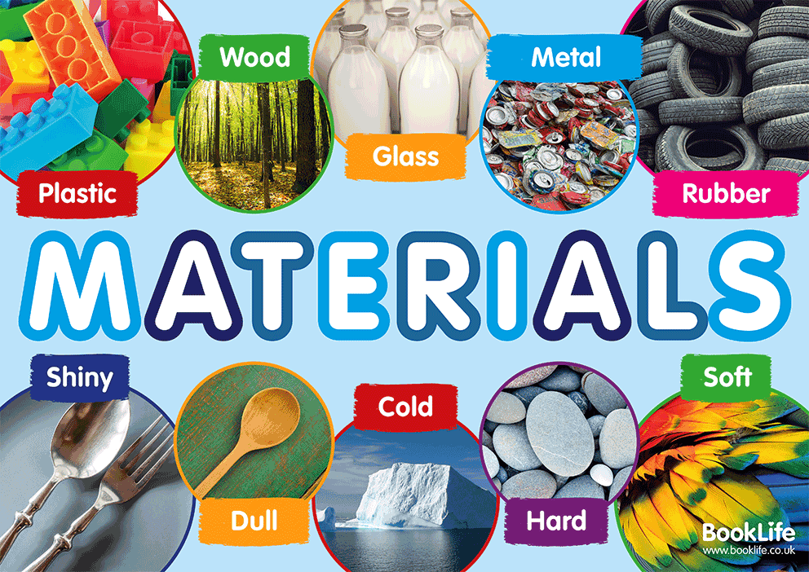



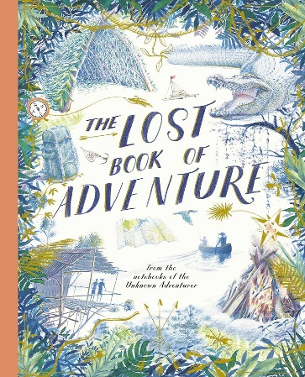



Year 5 Learning Overview
Lent Term 1
Maths
Science
English
In this unit, we will be
using the text, ‘The Lost Book of Adventure’ as the stimulus for our writing. The text combines thrilling tales of adventure from around the world – such as surviving in different climates and lands. We will be using the text to
build towards writing a Survival Narrative, thinking about the possible threats and how explorers can deal with them to create an exciting composition.
We will be continuing to develop our appropriate use of verb
prefixes; verb suffixes; adverbs to indicate the degree of possibility; commas to avoid ambiguity and relative clauses using a range of relative pronouns.
We are reading...
This half term we will be developing our understanding of fractions by looking at equivalent, mixed and improper fractions. We will then progress to look at decimals, making links between the fractions and the corresponding decimals.
We will also be looking at our Geometry targets thinking about the properties if shapes, specifically focusing on angles.
This half term, pupils will complete their learning on different materials and their properties, such as hardness, flexibility, transparency, and conductivity.
Following this, pupils will focus on their new learning about Forces. They will consider forces such as gravity, friction, air resistance and water resistance and explore machines such as levers, pulleys and gears while developing skills in asking questions, carrying out fair tests and explaining results using scientific vocabulary.
We will continue to work on our spelling rules. Spellings will be tested on a Monday every week
We will focus in our whole class reading on developing our understanding of new vocabulary, fluency, prosody and comprehension skills using The Lost Thing by Shaun Tan and Clock Work by Philip Pullman.
RE
To the Ends of the Earth
In this branch, pupils explore the Big Question, ‘How can we use the gifts of the Holy Spirit to be better disciples of God? To build knowledge, pupils will identify that scripture speaks of the outpouring if the gifts of the Holy Spirit on the Messiah. They will learn to describe the gifts of the Holy Spirit and think about how they help and inspire Christians to be good disciples. They will make links between the gifts and the Sacrament of Confirmation and explain discipleship with reference to a powerful example that they look up to. Pupils will consider whether/how the Sacrament of Confirmation helps Christians to grown in virtue. The main focus for their learning consider how they can use the gifts and virtues to be good disciples in today’s world.

Slide 2



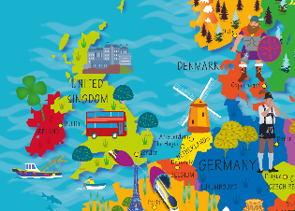
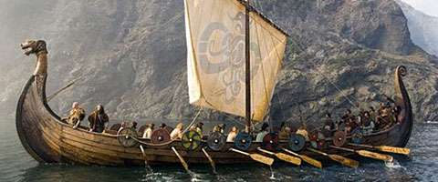



History and Geography
Music
RSHE
Vikings
Pupils will complete their learning about the Viking invasion of Britain. They will be historians thinking about drawing conclusions based on sources and thinking about the change and continuity in Britain during this time.
Europe
Pupils will develop their locational knowledge focusing on the continent of Europe. They will know a continent is a large land mass and a group of countries, knowing the names of eight European countries, capital cities and other major cities. They will consider key physical and human characteristics of some countries in Europe.
Dancing in the Street
Within this unit, pupils will focus on improvisation. They will use all of the skills from the previous units to listen and apply their understanding to improvise and play a melody. In this learning, they will be introduced to semi-quavers and use these notes within their improvisation.
Created to love in Community and British Values and Economic Wellbeing
Pupils will continue to focus on understanding how to apply their thinking about British Values to support us all to live well in community together.
They will then focus on learning about Economic Wellbeing, considering how we can make our money stretch further, thinking about budgeting and risks associated with money.
Computing
Art and DT
PE
Stop Motion Animation and Online Safety:
Pupils will continue to learn how to create a short stop-motion animation thinking about using small changes between images. Pupils will think of a simple story for their animation. Pupils will also be focusing on Online Safety and how they can look after themselves and others online. They will explore inline communication, protecting personal information and offering advice to combat the negative effects of online use.
Pupils will continue to explore how to
create portraits using a variety of mixed
media They will learn about proportions and
features of the human face, experiment with texture, colour, and layering, and study examples of portrait art from different artists and cultures..
Pupils will also focus on exploring how bridge designs and materials affect strength and stability through building a bridge. They will identify stronger and weaker supporting shapes to improve the strength and evaluate the success of our structures.
Athletics
During this term, pupils will focus on their athletics skills to prepare for Sports Day. They will develop skills in many areas including throwing, running, jumping and focusing in developing skills, accuracy and stamina within these different areas.
PE will take place on a Thursday and Fitness will be on a Friday so please wear full PE kits.

