Slide 1
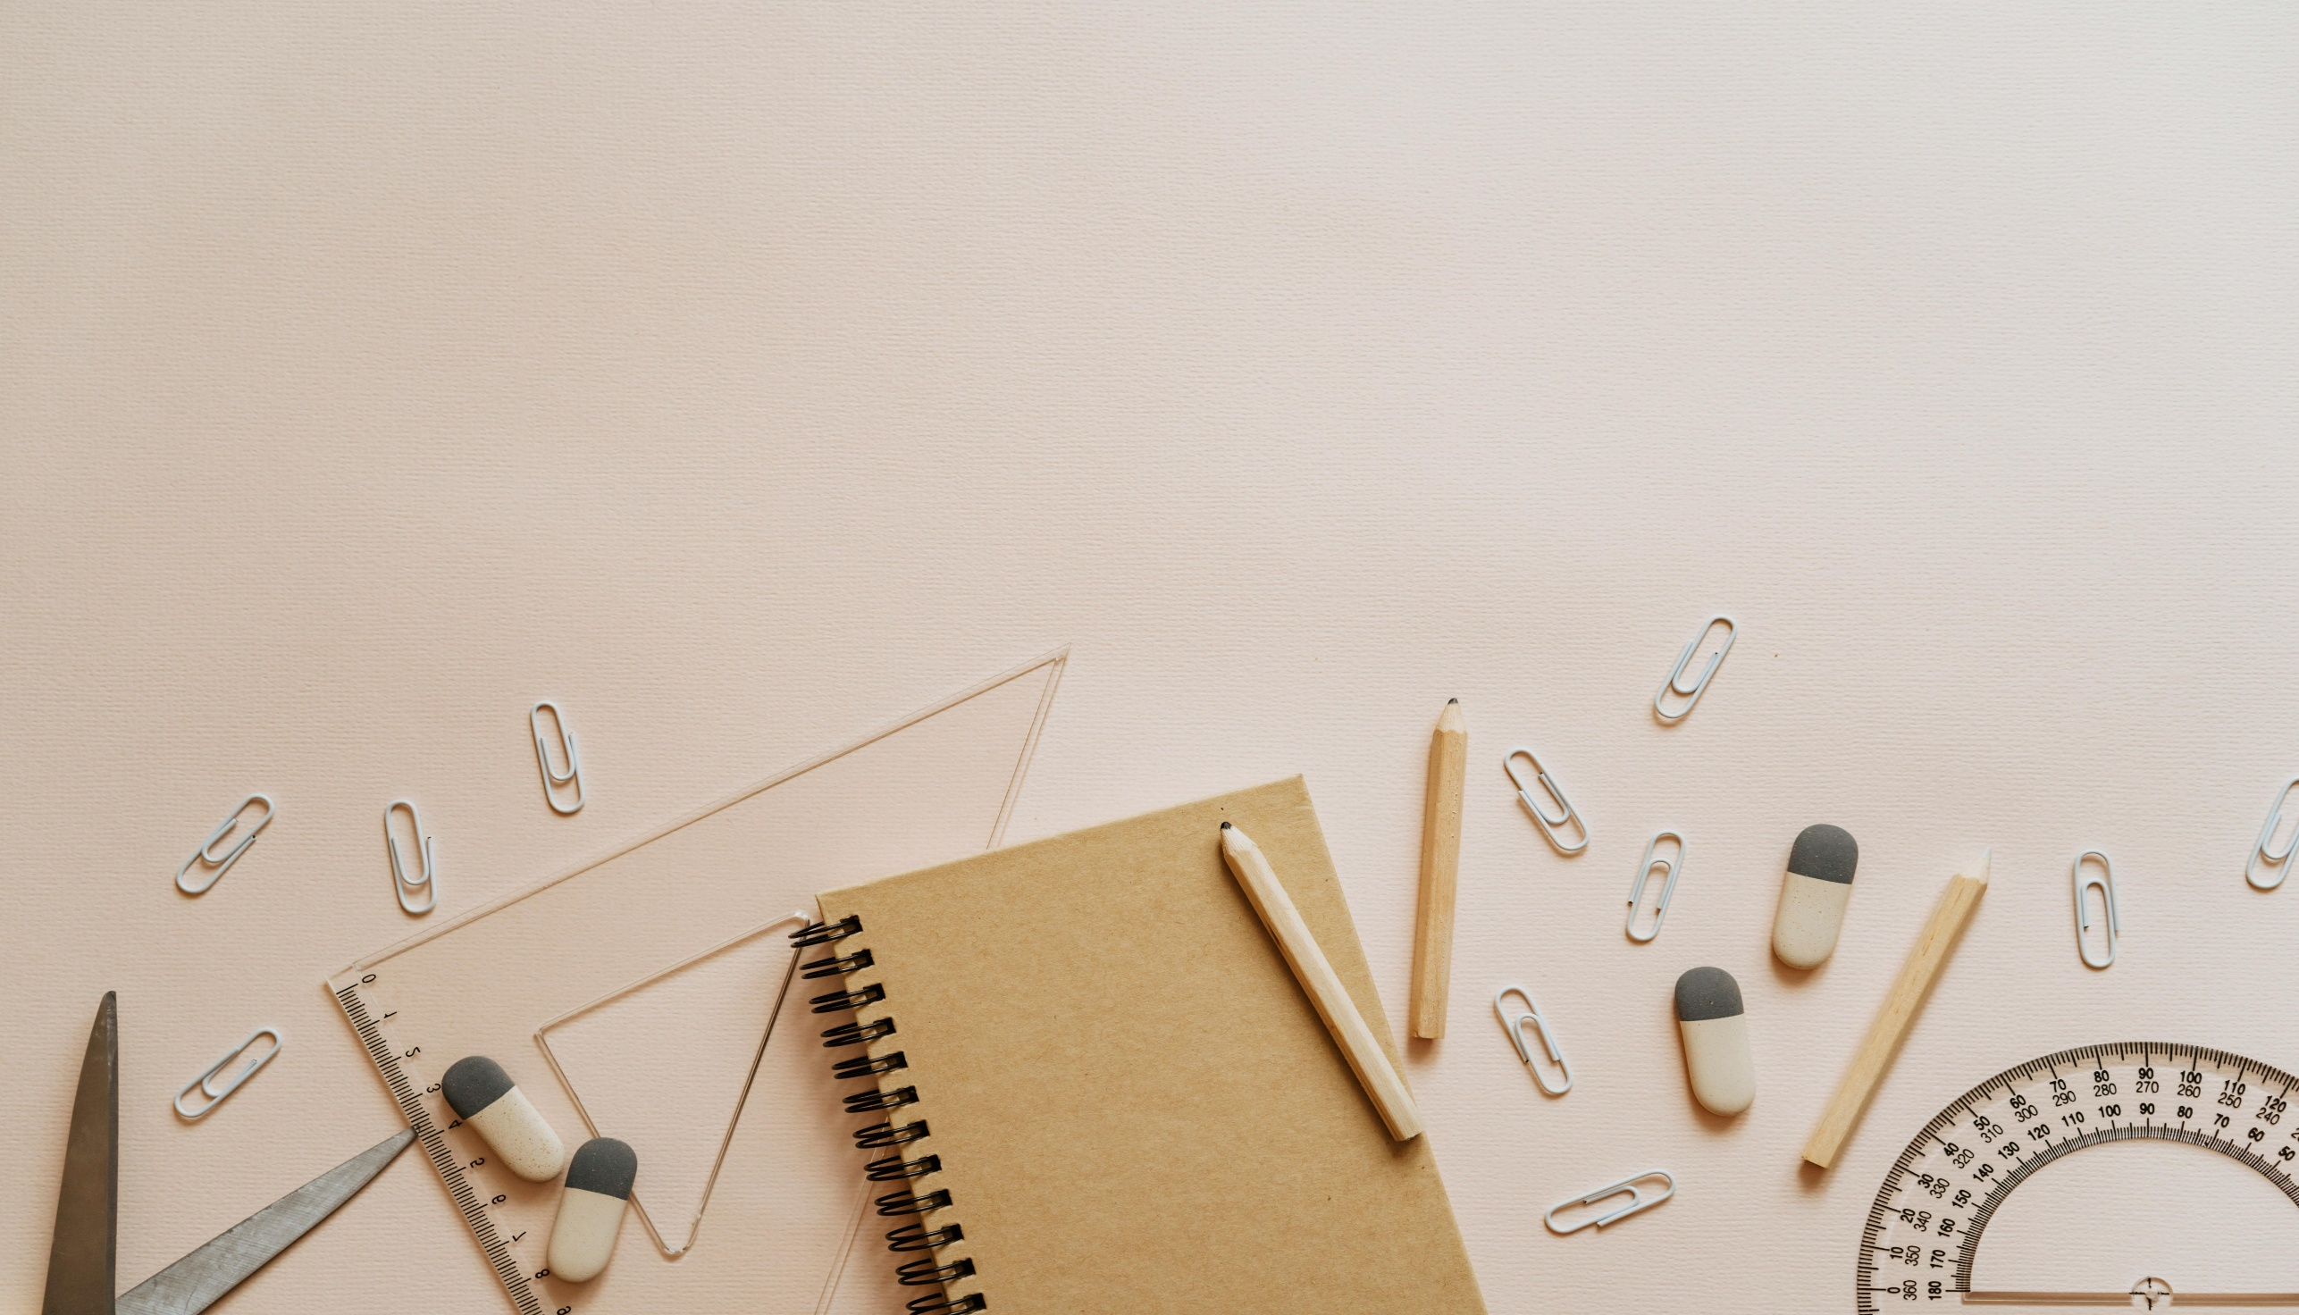
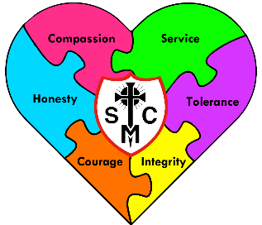





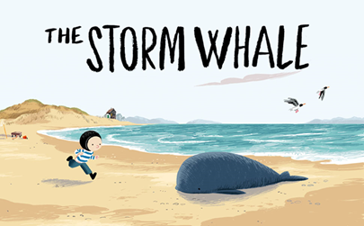



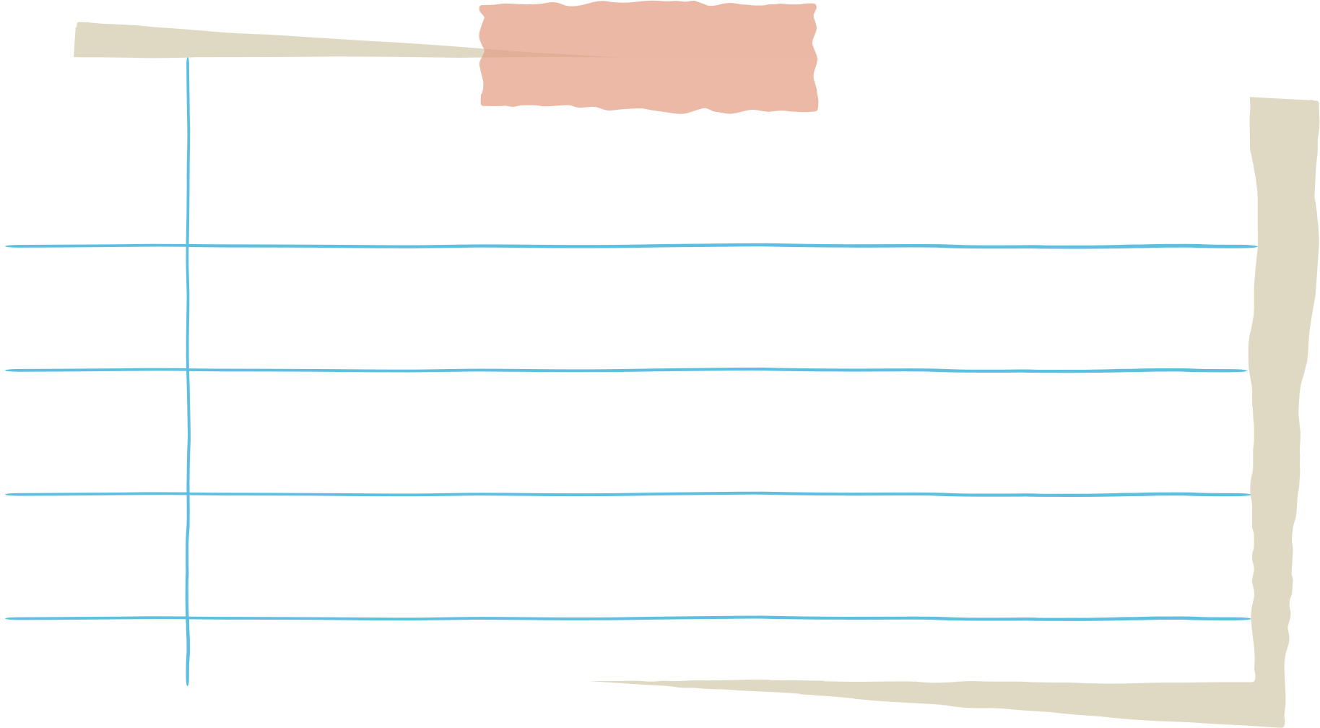
F2 Learning Overview
Pentecost 1
Understanding the World
Literacy
Maths
The Natural World:
Know some similarities and differences between the natural world around me and contrasting environments, drawing on experiences and what has been read in class.
People, Culture and Communities:
  Make comparisons of settings and fictional settings.
  Explain some similarities and differences between life in this country and other countries, drawing on knowledge from stories, non-fiction texts and, when appropriate, maps.
  Past and Present:
  Comment on images of familiar situations in the past.
  understand the past through settings, characters and events encountered in books read in class and storytelling.
We are reading...
We will be looking at:
3D Shapes
Building numbers beyond 10.
Verbal counting beyond 20.
How many now? Adding and take away.
Sharing and grouping.
Even and odd.
Doubles.
Comprehension:
Listen to stories, accurately anticipating key events & respond to what they hear with relevant comments, questions, and reactions.
Writing:
Write for a purpose in role play using phonetically plausible attempts at words whilst beginning to use finger spaces.
Phonics
We follow the Little Wandle scheme.
Graphemes:
Review all Phase 3 sounds
Tricky words::
said, so, have, like, some, come, love, do, were, here, little, says, there, when, what, one, out, today.
RE
To the Ends of the Earth
This half term in RE, we are learning about the coming of the Holy Spirit at Pentecost and how the early Christians shared the Good News of Jesus through their actions and community life. We are exploring how we are all called to live together as one family, remembering that everyone is a child of God. Even though we may be different, we are all connected, like one big family holding hands, and we are learning how to care for and love one another just as Jesus taught us.

Slide 2



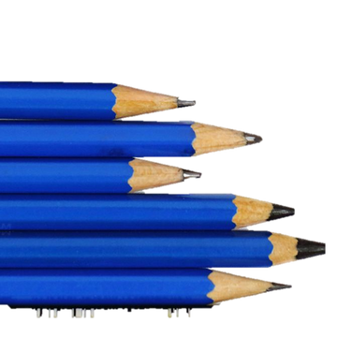
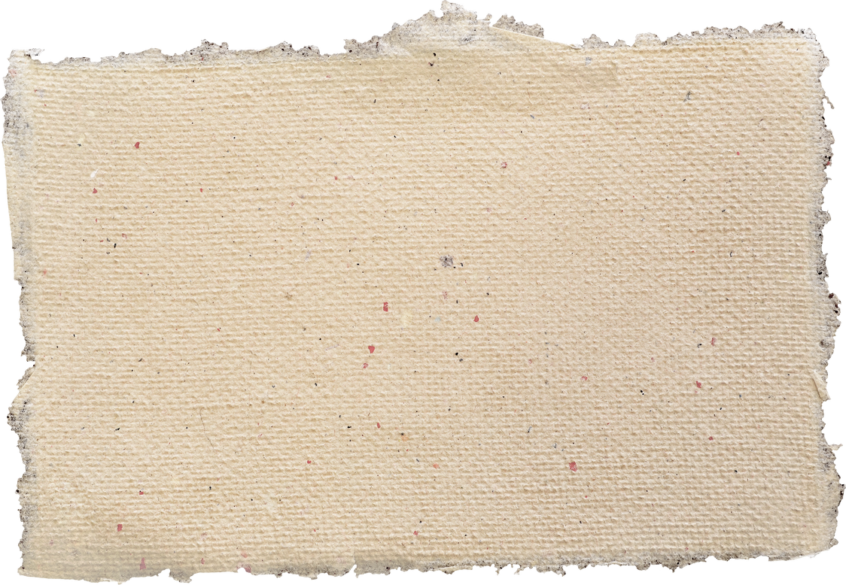
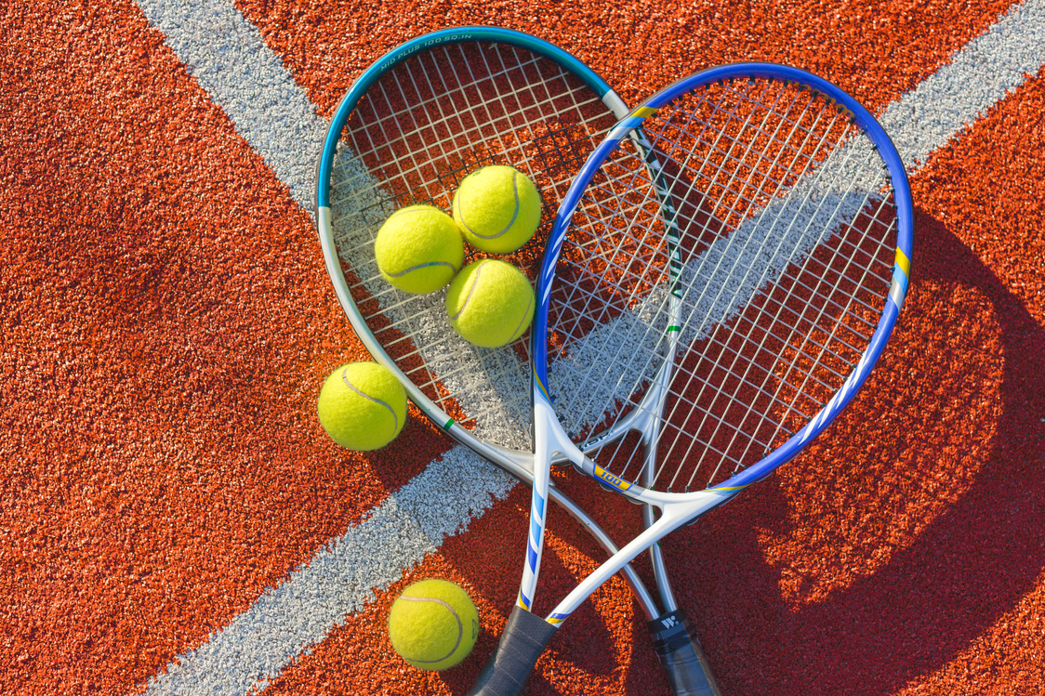
PSED
Physical Development
Self-regulation:
Understand own and other people’s feelings, offering empathy and comfort.
Take steps to resolve conflicts with other children by finding a compromise sometimes with support.
Managing self:
Try new activities and show independence, resilience, and perseverance in the face of challenge.
Know the reasons for rules, know right from wrong and try to behave accordingly.
Dress and undress mostly independently.
Building relationships:
Frequently play cooperatively and take turns with others.
Form positive attachments to adults and friendships with peers.
Show sensitivity to their own and to others’ needs.
Communication and Language
Fine Motor Skills:
Develop the foundations of a handwriting style which is fast, accurate and efficient..
Gross Motor Skills:
Develop the overall body strength, co-ordination, balance and agility needed to engage successfully with future physical education sessions and other physical disciplines including dance, gymnastics, sport and swimming.
Listening:
Follow a story without pictures or props.
Understand and use questions such as who; why; when; where and how.
Speaking:
Use language to imagine and recreate roles and experiences in play situations.
Link statements and stick to a main theme or intention.
Expressive Arts and Design
RSHE
PE
Creating with Materials:
Explore different textures.
Draw with details.
Work in a group to create a box model, listening to each other’s ideas about how to improve and change their model.
Explain how they have made a model and what its purpose is.
Being Imaginative and Expressive:
Change the tempo and dynamics whilst playing music.
Use a wide variety of instruments.
Begin to understand emotion through music and describe music in simple term e.g. ‘happy’, ‘sad’ or ‘scary’.
Use familiar stories to innovate small world play with their peers
Use the outside areas (stage/boat/trim-trail) to act out familiar stories and change them with their peers.
Economic Well-being
Developed through continuous provision in Maths and Role Play areas.
Coordination and balance
Children are able to show good control and coordination in large and small movements.
To move with confidence and coordination on simple equipment.

