Slide 1










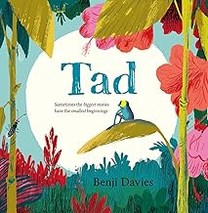

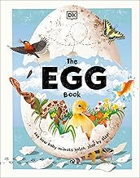

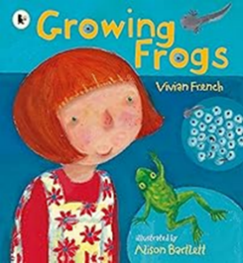




Nursery Learning Overview
We are reading...
Lent term 2
Our topic is ‘Where the wild things are
English
Maths
RSHE
Economic well-being
We will be playing in our shop and learning that we need money to but things and gaining an understanding that some things we need and others we want but don’t need them.
In Reading we will be suggesting how the story might end.
In Writing we will be. imitating adults’ writing by making continuous lines of shapes and symbols (early writing) from left to right and beginning to write some letters.
n Phonics we will be using the Programme ‘Little Wandle to start to learn sounds u r h b f l and playing phonics games in groups.
We will continue to do ‘Rhyme Time’ where we will play games that develop our:
Listening, Syllables, Rhyming, Alliteration and Sound Knowledge We will be elarning the rhymes – Mary, Mary quite contrary, Round and round the garden and Ring a ring a roses.
We will be looking at:
  Number 6
  Height and Length
  Mass
  Capacity
We are reading...
RE
In Love of Reading we will be reading the books;
‘Erol’s Garden’ and ‘Where’s Lenny?’
This term, children in Nursery we will be learning about ‘Desert to Garden’. We will be learning about that Lent is a time to get ready, to k now Lent is a time to get closer to Jesus, to know Lent is a time to grow in love for others,
To know Jesus came to Jerusalem on a donkey (Palm Sunday), to know that Jesus died on the cross and it is a sad time (Good Friday) to know that Jesus rose again on Easter Sunday

Slide 2






Understanding the World
Fine motor skills
PE
Movement to Music
To explore and copy basic body actions led by the teacher.
To show a degree of control and balance when moving.
The Natural World:
Talk about what pets they have.
Know the difference between plants and animals
Plant seeds and care for growing plants
Understand the key features of the lift cycle of an animal.
Understand the key features of the life cycle of a plant
Begin to understand the need to respect and care for the natural environment and all living things
Talk about what they see, feel, smell, hear, taste using a wide vocabulary .
Be able to take shoes and socks off and put them back on independently.
Show increasing control when threading, cutting, drawing.
Expressive Ar t and Design
Communication and language
Gross Motor
Creating with Materials
Draw with increasing complexity and detail, such as representing a face with a circle and including details
Show different emotions in my drawings (happiness, sadness, fear etc.)
Create collages using mixed media.
Use drawing to represent ideas like movement or loud noises.
Safely use and explore a variety of materials tools and techniques.
Being imaginative and expressive
Make imaginative and complex 'small worlds' with blocks and construction kits, such as a city with different buildings and a park.
Play instruments with increasing control to express feelings and ideas
Begin to understand ‘how’ questions.
Know many rhymes, talk about familiar books and tell a long story.
Understand simple concepts of a new thing e.g. full and empty. (Link to Maths and Height and Length, Mass and Capacity)
Go up steps and stairs, or climb up apparatus, using alternate feet.
Match their developing physical skills to tasks and activities in the setting. E.g. they decide whether to crawl, walk or run across a plank, depending on its length and width

