Slide 1









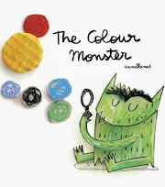



Nursery Learning Overview
We are reading...
Advent Term 1
Our topic is ‘Marvellous Me!’
English
Maths
RSHE
We will begin by looking at how God created the world and made us unique. Together will make giant collage to show the creation.
To remind ourselves of just how wonderful we are, will be celebrating what makes us special and different from each other.
Sharing things that we love and things that we are so good at will help us to get us to know each other better.
By singing songs and playing games we will be learning our different body parts.
We will be looking at:
  Colours
  Matching
  Sorting
  Say some numbers orally by counting daily and singing counting songs
We will be enjoying songs and rhymes - learning the Nursery Rhymes 1,2,3,4,5, Baa baa colours sheep , Twinkle Twinkle little star, Humpty Dumpty, Row, row, row your boat, Dingle dangle scarecrow.
We will be learning about the five key concepts of print and enjoying sharing books with an adult. We will be copying finger movements and other gestures by using Wiggle Me into Squiggle Movements. We will be mark making using a range of materials by painting with whole hands, different parts of the body, using shaving foam, different sized paintbrushes, chalks, charcoal, oil pastels, mud, and water.
We are reading...
We will be using the Programme ‘Little Wandle Foundations’.
This half term we are focusing on ’Rhyme Time’. In sessions, every day, we will play games that develop learning on ; Listening, Syllables, Rhyming, Alliteration, and Sound Knowledge.
RE
This term, children in Nursery will hear the creation story and learn that God made them. They will consider ways they can look after themselves. To build on this, they will learn that God made the world and consider ways in which we can look after the world and care for God’s creation. By the end of the unit, all children will know that they are invited to be part of God’s family. At home you could read the Creation Story (Genesis 1:31).

Slide 2



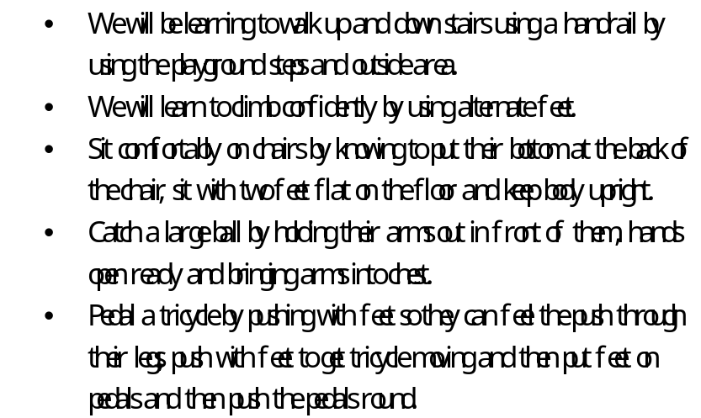

Understanding the World
Fine motor skills
PE
Past and Present:
We will be learning some people were born before us so are older than us and some born after us so are younger than us by putting pictures of brothers and sisters and other family members in before and after.
People, Culture and Communities
We will be learning about occupations that familiar people have by talking about the jobs our parents and familiar adults have. Showing an interest in how things work by using wind up toys, cogs and pegs and boards. We will be able to talk about members of our families and people who are important to us by saying something about them.. We will be talking about and pointing to what we see in our own environment by sorting things we see at school and at home.
Developing manipulation and control. Use cutters to cut a shape from modelling materials, use rollers to roll the play dough , squeeze it in hands and use cutters and play dough scissors.
Use various tools to make marks with thumb and all fingers, Chunky paintbrushes on tables and then on chalkboards progressing to medium and then finer paintbrushes
Turn pages of books in reading area and at home when reading in Storytime.
We will be learning:-
that equipment needs to be used safely and that our bodies will feel different whilst exercising and we can participate in physical activity on our own or with others.
Listen during carpet sessions by using ‘Give me five’.
Show that they understand action words by pointing to the right picture in a book. By doing actions and then looking in the book and find one of the actions they have done.
Say how they are feeling, using words as well as actions.(Happy/Sad)
Using 3 word phrases by building up from a gesture to speaking three words e.g.
I am happy
I am sad
Can I play?
Expressive Ar t and Design
Communication and language
Gross Motor
Creating with Materials
Start to make marks intentionally by using various different tolls and materials.:
Explore paint using hands and other body parts as well as brushes and other tools.
Make simple models using various construction toys and other objects.
Being imaginative and expressive
Enjoy taking part in pretend play by using the Home Corner
Enjoy taking part in songs by learning Nursery Rhymes and other songs.
Enjoy moving to music by dancing and moving to music in class
Explore a range of sound-makers and instrument
by making sounds using various instruments and ways to play them softly and loudly and using different parts of the body.

