Slide 1

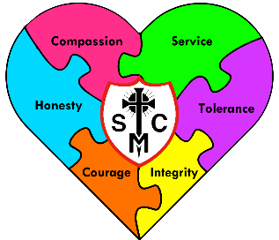



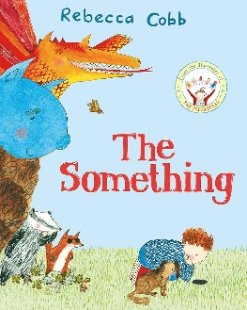

F2 Learning Overview
Advent Term 1
Understanding the World
Literacy
Maths
Word reading:
Recognise initial sounds
Comprehension:
Join in with rhymes and show an interest in stories with repeated refrains.
Sequence familiar stories using pictures.
Draw pictures of characters, events, settings in a story.
Writing:
Give meaning to marks whilst holding my pencil in a tripod grip.
Write initial sounds and simple captions.
We will be looking at:
Matching and sorting objects.
Comparing mass, size and capacity.
Exploring and creating simple patterns.
Subitising and representing numbers 1,2 and 3.
People, Culture and Communities:
  Talk about members of their immediate family and community.
  Name and discuss people who are familiar to them.
  Know about significant individuals.
  Draw information from a simple map.
  Past and Present:
  Comment on images of familiar situations in the past
  The Natural World:
  Recognise some environments that are different to the one in which they live.
We are reading...
Phonics
We follow the Little Wandle scheme to introduce the children to Phase 2 graphemes.
Graphemes:
s,a,t,p,i,n,m,d,g,o,c,k,ck,e,u,r,h,b,f,l.
Tricky words:
I, is, the
RE
Creation and Covenant
This term, children in EYFS will hear the creation story and learn that God made them. They will consider ways they can look after themselves. To build on this,
they will learn that God made the world and consider ways in which we can look after the world and care for God’s creation. By the end of the unit, all children will know that they are invited to be part of God’s family.

Slide 2




PSED
Communication and Language
Physical Development
Fine Motor Skills:
Show a preference for a dominant hand.
Create lines and circles pivoting from the shoulder and elbow.
Gross Motor Skills:
Revise and refine the fundamental movement skills they have already acquired: rolling, crawling, walking, jumping, hopping.
Use their core muscle strength to achieve a good posture when sitting at a table or sitting on the floor.
Further develop the skills they need to manage the school day successfully – lining up and queuing.
Self-Regulation:
Show attention to the teacher, usually respond appropriately.
Show understanding of their own feelings and those of others.
Managing Self:
Begin to recognise the impact of their actions.
Explore feelings through role play.
Enjoy trying new healthy snacks at snack time.
Building Relationships:
Build relationships with familiar adults.
Play with other children.
Listening:
Enjoy listening to longer stories and to others in one-to-one small groups, when conversation is of interest to them.
Listen carefully to rhymes and songs, paying attention to how they sound.
Engage in story times.
Speaking:
Begin to learn new vocabulary and use it.
Learn rhymes, poems and songs.
Develop social phrases e.g. To say hello in response to an adult.
Expressiuve Arts and Design
Music
RSHE
Creating with Materials:
Begin to draw self-portraits, landscapes, and building/cityscapes.
Build models which replicate those in real life, using a variety of resources.
Being Imaginative and Expressive:
Sing in group or by oneself, increasingly matching the pitch and following the melody.
Sing a range of well-known nursery rhymes and songs.
Explore and engage in music making and dance, performing solo or in groups.
Settling In Songs
Recap of Nursery Rhymes
Created and Loved by God
I like, you like, we all like
All the feelings!
Let’s get real
Growing up
New people, new places
PE
Introduction to PE
Develop gross motor skills, spatial awareness and cooperative play.
Revise and refine the fundamental movement skills they have already required.

