Slide 1

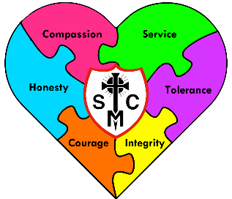




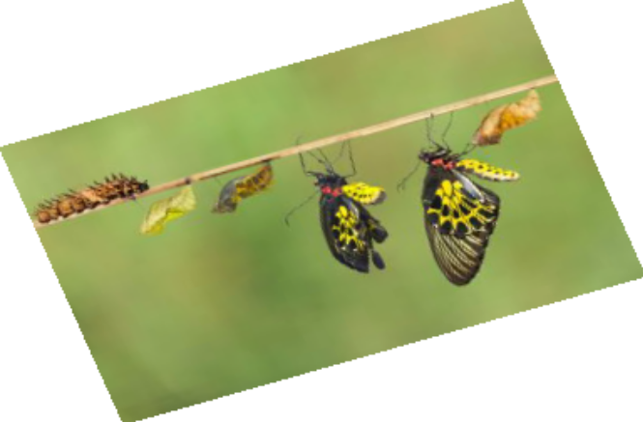

Year 5 Learning Overview
Advent Term 1
English
Maths
Science
This half term we will be learning about Life Cycles. Our learning will be to explain the seven life processes as well as investigating how different animals reproduce and why. Pupils will then identify the life cycles of different animals and plants and investigate the different ways plants can reproduce. Finally, they will identify the changes that humans experience during their life cycle.
For the first half term, we will be focusing on ‘Foundations for Success’ where we will learn about the place value of punctuation and grammar. This unit will allow pupils to build on their understanding of the value of each part of a sentence, thinking about how small changes can affect meaning, clarity and readability. This understanding will help pupils to construct their own sentences in sentences with more confidence, which will support them as they work through Year 5.
This half term we will be looking at:
Place value up to 1 million, including opportunities to compare and order numbers
Rounding numbers within 100,000 and understanding the accurate method to use
Counting in powers of 10
Understanding negative numbers
Understanding Roman Numerals
Measure and calculate perimeter
Area of rectangles, compound and irregular shapes
We are reading...
In our Reading Lessons, we will be focusing on our fluency and comprehension skills. We will work on responding to clues in the text, such as punctuation, word clues, run on lines and chunked text and then use our Super Six comprehension strategies to find meaning in given texts. Our key focus this half term will be drawing inferences and summarising the main ideas.
RE
Creation and Covenant
In this branch, pupils will learn about Moses, focusing on the two key events of the call and the covenant (the Burning Bush and the Sinai covenant and the Ten Commandments). They will
make links between the Ten Commandments and Jesus’ summary of the law in Matthew’s
Gospel. We will focus on how the Ten Commandments help human beings to live good and happy lives as well as think about how sin is the act of deliberately spoiling our friendship with God
and each other. Pupils will learn more about positive habits (virtues) and negative habits and
how virtues might help them to grow in goodness. Finally, pupils will discuss what loving our neighbour means for Christians today, for example, welcoming asylum seekers and refugees,
and relating this belief to the Church’s teaching on the common good and love of neighbour.

Slide 2
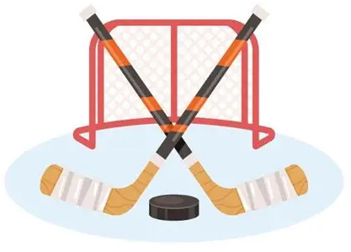



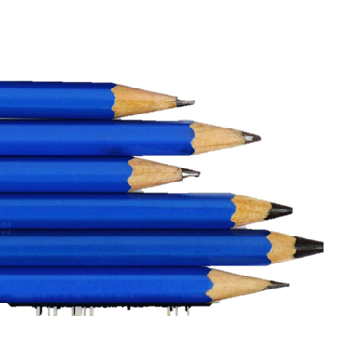
Geography
Music
PE
We are Geographers inspired by our fascination of the world and its people.
We will be developing our locational knowledge by comparing Nottingham with North America. To do this, we will explore similarities and differences of human and physical geographical features.
We will be learning about:
  Where both places are located and different physical and human features that can be found in each location
  How to use maps, atlases and digital mapping to locate and describe the features studied
Our Music work this half term will be to learn how to conduct and be able to conduct along to recorded music and to use these skills to alter the music they play as a class.
The unit of learning will build upon their prior knowledge of listening, reviewing and evaluating music from different historical periods, performing together and improvising on one or two notes on an instrument.
We will be continuing to develop our skills in reading stave notation and describing the structure of music in terms of beginning, middle and end.
Hockey will be our focus for PE
this half-term. The skills that the children will develop will be:
To receive a ball with control whilst moving
To use space without the ball as part of an attacking team
To communicate with team mates to retain possession in small sided games
Spanish
RSHE
Computing
¿Tienes una mascota? (Do You Have a Pet?) By the end of this unit pupils will have the knowledge and skills to present both orally and in written form about the pets they have and/or do not have.
Computing Systems and Networks:
Our first unit will be focused on Search Engines. Pupils will be identifying hardware and using software, while exploring how computers communicate and connect to one another.
Pupils will know how to:
Explain what a search engine is, suggest several search engines to use and explain how to use them to find websites and information
Suggest things online are not always true and recognize what to check for
Explain why keywords are important and what TASK stands for, using these strategies to search effectively
Recognise the terms ‘copyright’ and ‘fair use’ and combine text and images in a poster.
Make parallels between book searching and internet searching, explaining the role of web crawlers and recognising that results are rated to decide rank.
Created and loved by God
We will be looking at exploring the individual through the church’s teaching that we are made in the image and likeness of God. We will be learning to value ourselves as the basis for our relationships and this includes looking at our bodies, learning that becoming adult is a natural phase of life and understanding the changes our bodies experience through puberty.
Art
We will be developing our drawing skills by sketching, choosing and combining materials to create texture, use printing techniques and evaluate our work to
make improvements.

